Slide 1
KAUST Bioinformatics Summer School
Week 1 mini-presentations
Epidemiology modelling

Slide 2
How to prepare your slide
Slide title: the question that you wanted to answer.
Include one figure from your analysis.
Add a few sentences to the slide:
(1-2 sentences) What did you do to answer the question, i.e. what analysis you ran.
(1-2 sentences) Your results/conclusions, which directly answers the question in the slide.
Add a new slide to this presentation with your name and question

Slide 3
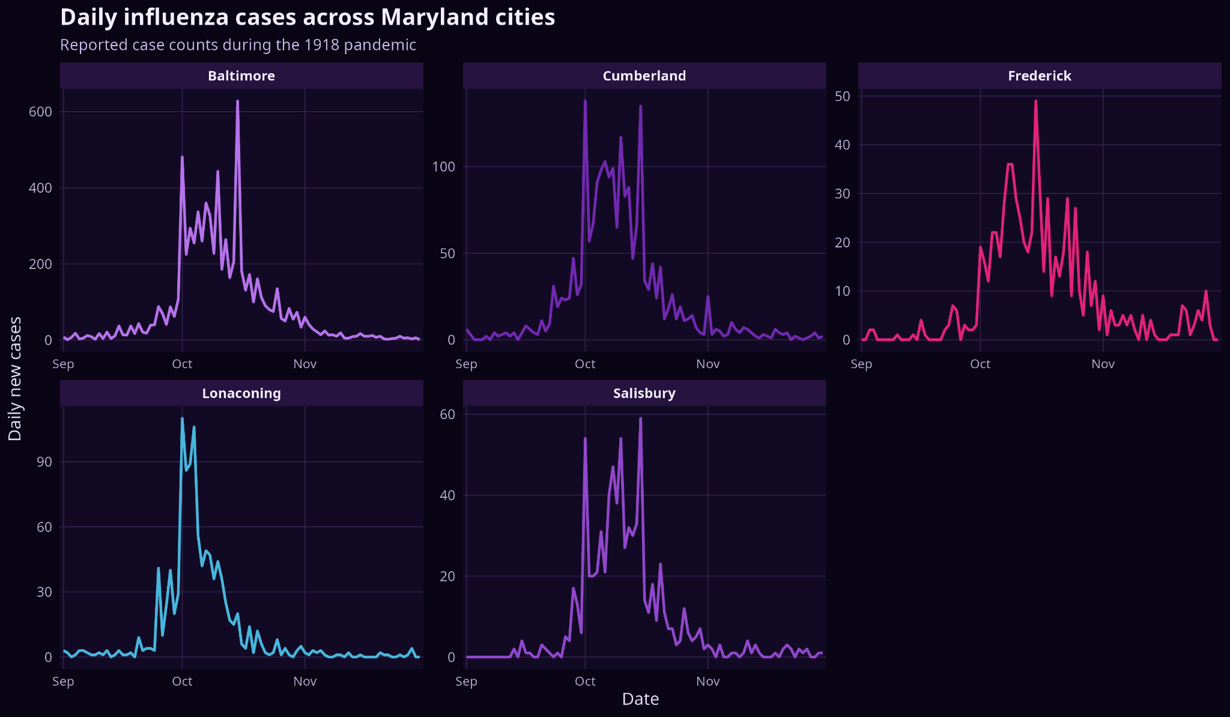
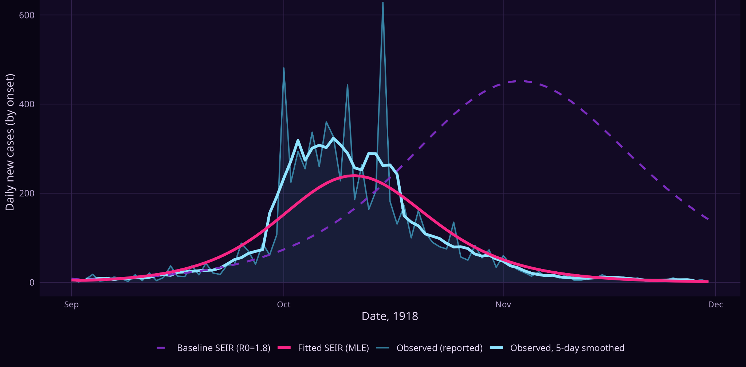
Baltimore was the richest case study; fitting improved the model / Almokhtar Aljarodi
The workflow moves from all-city exploration to a baseline SEIR model, then to a fitted Baltimore model.
1 · WHY BALTIMORE?
2 · BASELINE VS FITTED MODEL
Model fitting improves the match to Baltimore
Best fit: R₀ ≈ 2.22; observation scaling ≈ 29%
Baltimore gave the most information for fitting
33,776
7,489
628
surveyed population
observed cases
peak daily cases
City
Surveyed
Observed cases
Baltimore
33,776
7,489
Model fitting improves the match to Baltimore
Baseline R₀ = 1.8 peaked too late, fitting estimated transmission, seed infections, scaling and dispersion.
Cumberland
5,234
2,085
R₀ ≈ 2.22
observation scaling ≈ 29%
Lonaconing
1,840
1,093
29% is a model-to-data scaling factor, not a directly measured reporting rate.
Frederick
2,420
750
Salisbury
1,735
765
Data: Frost & Sydenstricker 1919. Latent period 1.9 days and infectious period ≈4 days from Mills et al. Baseline R₀ = 1.8 from Biggerstaff et al.
Notes:
First, I explored all five Maryland cities. Baltimore had the largest surveyed population and the greatest number of observed cases, so I used it as the main modelling case study.
I chose an SEIR model because influenza includes a short delay between catching the virus and being able to pass it to others.
I started with literature-based values: an R0R_0R0​ of 1.8, a latent period of 1.9 days, an infectious period of about 4 days, and 10% initial immunity.
The baseline model peaked too late, so I used optim() to test different parameter combinations and find the best statistical match to the Baltimore data. This gave a fitted R0R_0R0​ of about 2.22.

Slide 4
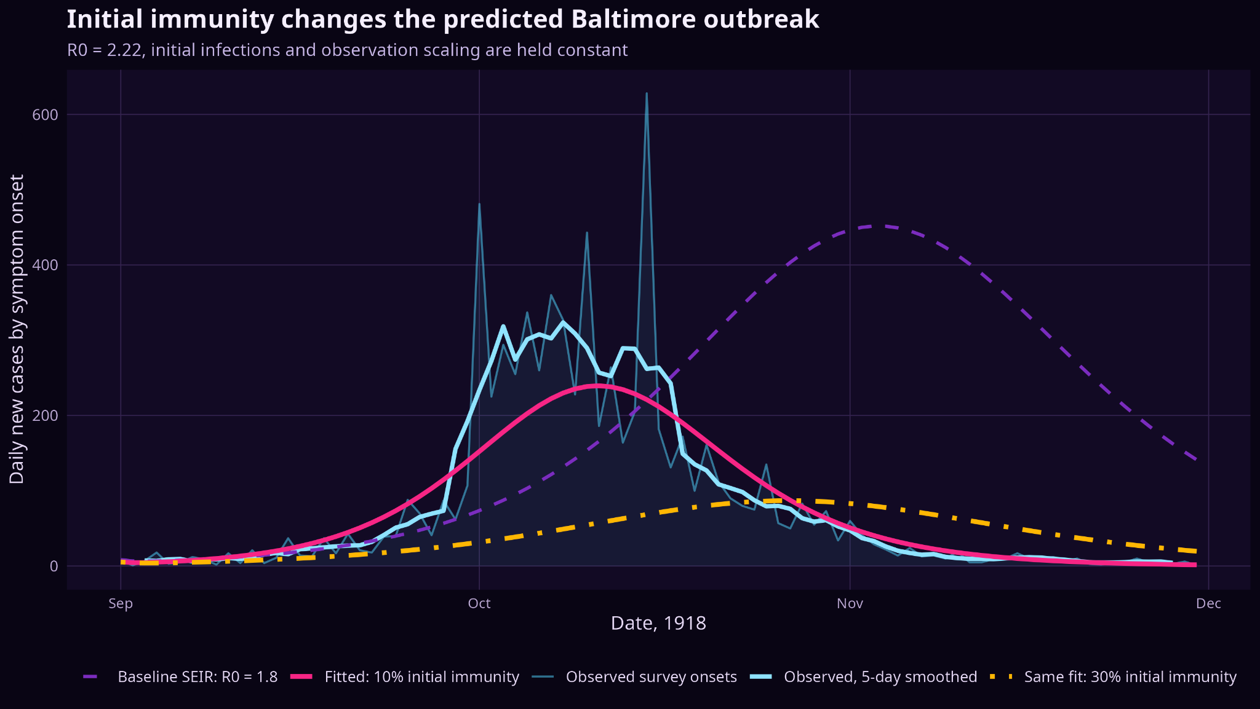
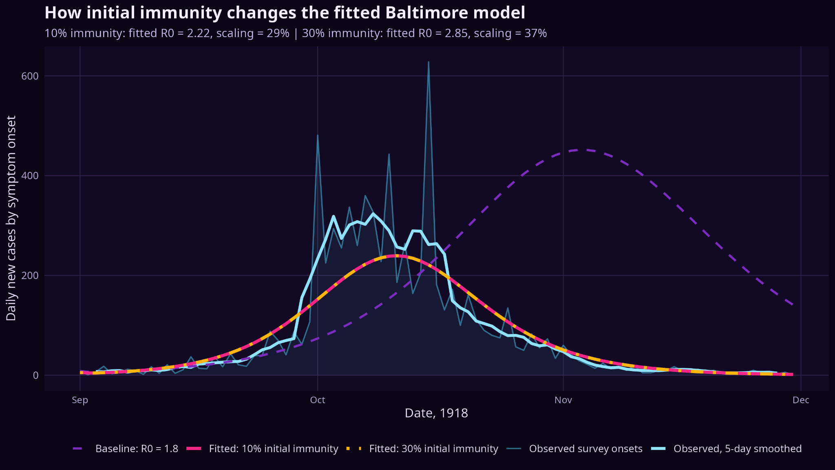
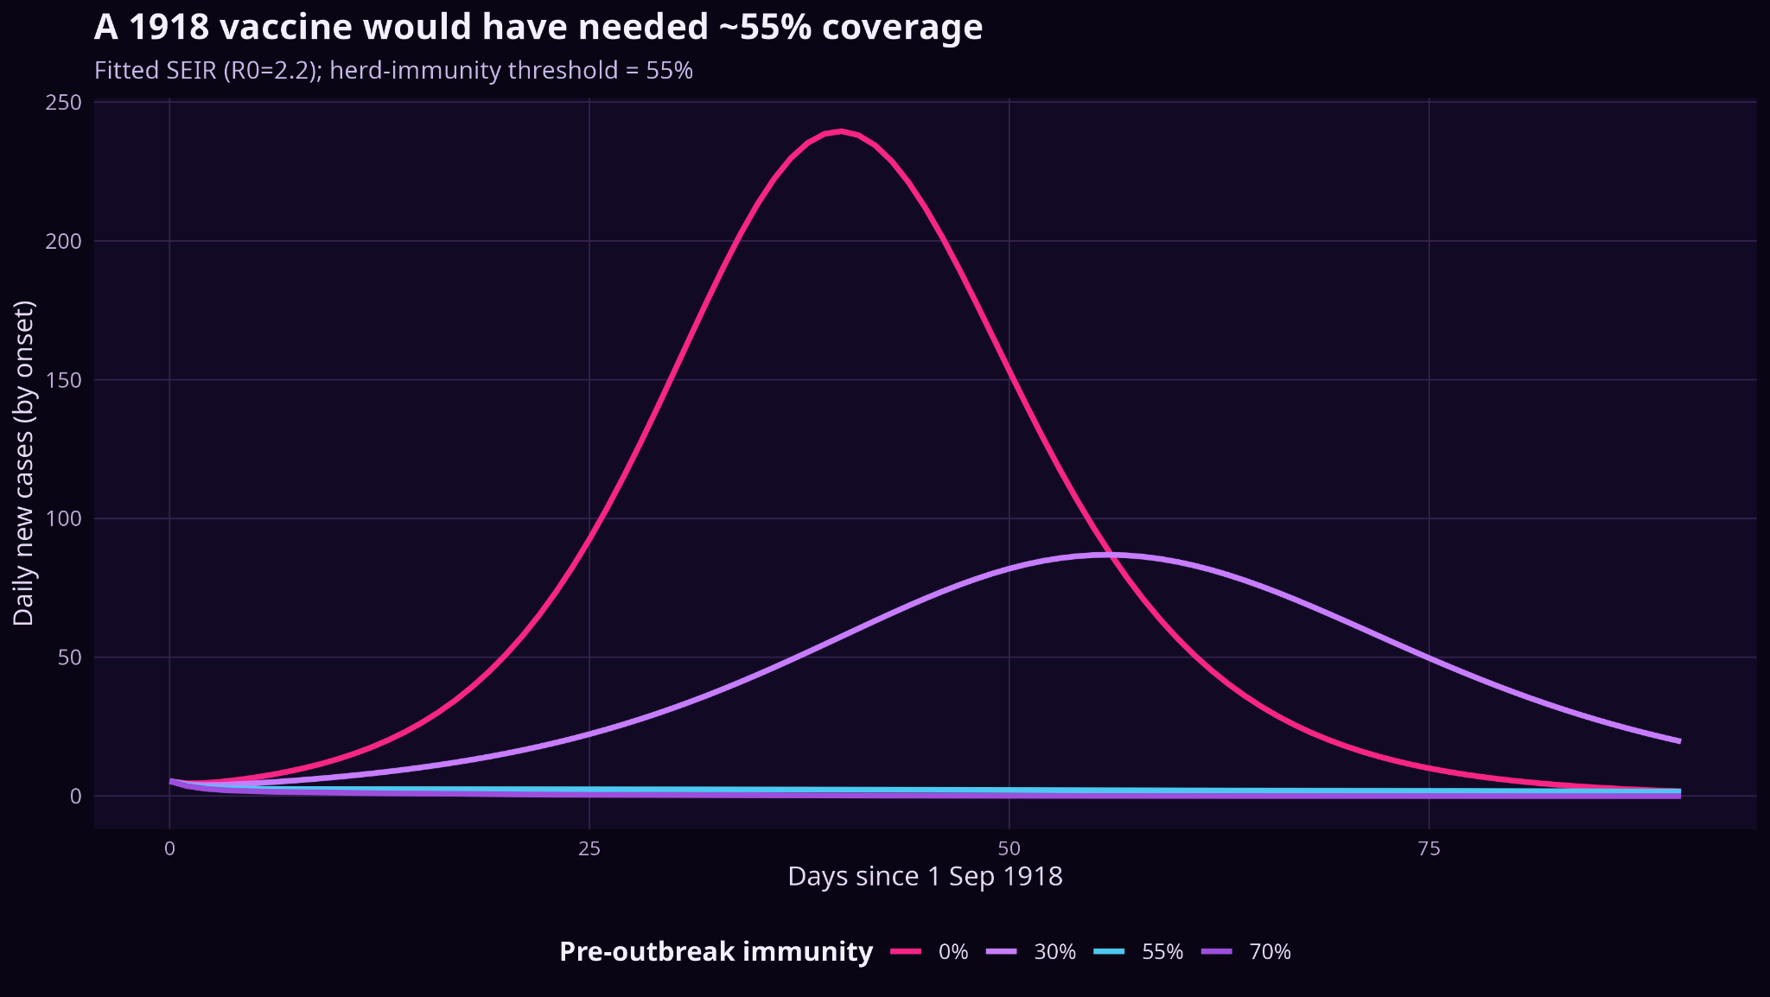
The 30% immunity question has two answers / Almokhtar Aljarodi
Holding R₀ fixed isolates immunity; refitting lets the model compensate by changing R₀.
A · SAME FIT: CHANGE ONLY IMMUNITY
B · REFIT: LET R₀ CHANGE
Why the lines overlap
When 30% immunity is fixed and the model is refitted, R₀ rises from 2.22 to 2.85.
C · INTERVENTION: PROTECTION THRESHOLD
What this proves
With R₀, seed infections and scaling held constant, 30% initial immunity makes the predicted wave much smaller and later.
With fitted R₀ ≈ 2.22, the simplified threshold is ~55% total pre-outbreak protection.
Notes:
Next, I tested the effect of initial immunity.
When I kept R0=2.22R_0=2.22R0​=2.22 fixed and increased immunity from 10% to 30%, the outbreak became smaller and later.
I also refitted the model with 30% immunity. The fitted R0R_0R0​ increased to about 2.85, while the curve remained almost the same.
This means the same case pattern can be explained by either lower immunity with lower transmission, or higher immunity with higher transmission. Ansd we can’t know which is true, until we have more data such as, antibody testing, and individual transmission estimate.
Finally, the hypothetical intervention suggested that around 55% total protection before the outbreak would be needed to stop sustained spread in this simplified model.

Slide 5
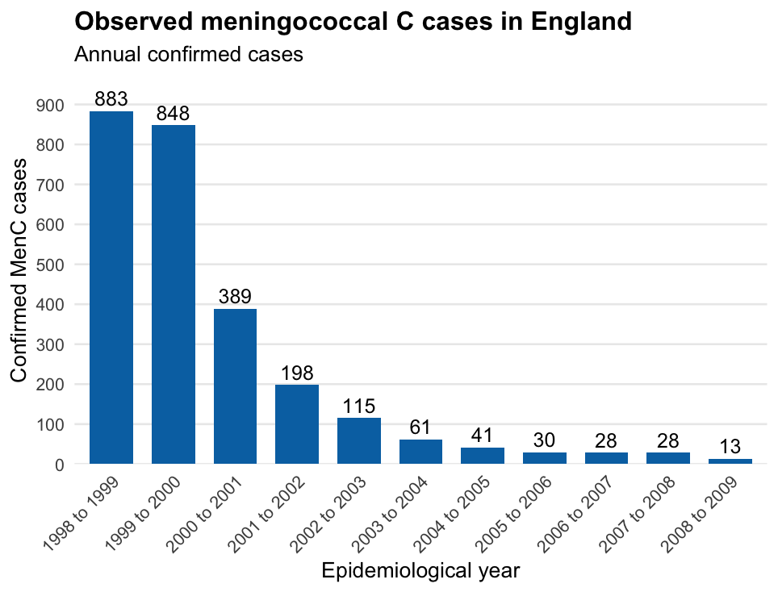
Modelling the impact of the MenC vaccination programme
Neisseria meningitidis - serogroup C outbreak, England 1998-2008
SVCIR model: Susceptible, Vaccinated, Carrier, Invasive disease, Recovered
𝜆S_{t}
𝛾C_{t}
S
C
R
𝜓S_{t}
𝛼C_{t}
𝛿I_{t}
V
I
Sara Althaqafi
Notes:
The parameter q represents the proportion of susceptible individuals successfully protected over the campaign. Derived from assumptions about the targeted population, uptake and vaccine effectiveness.

Slide 6
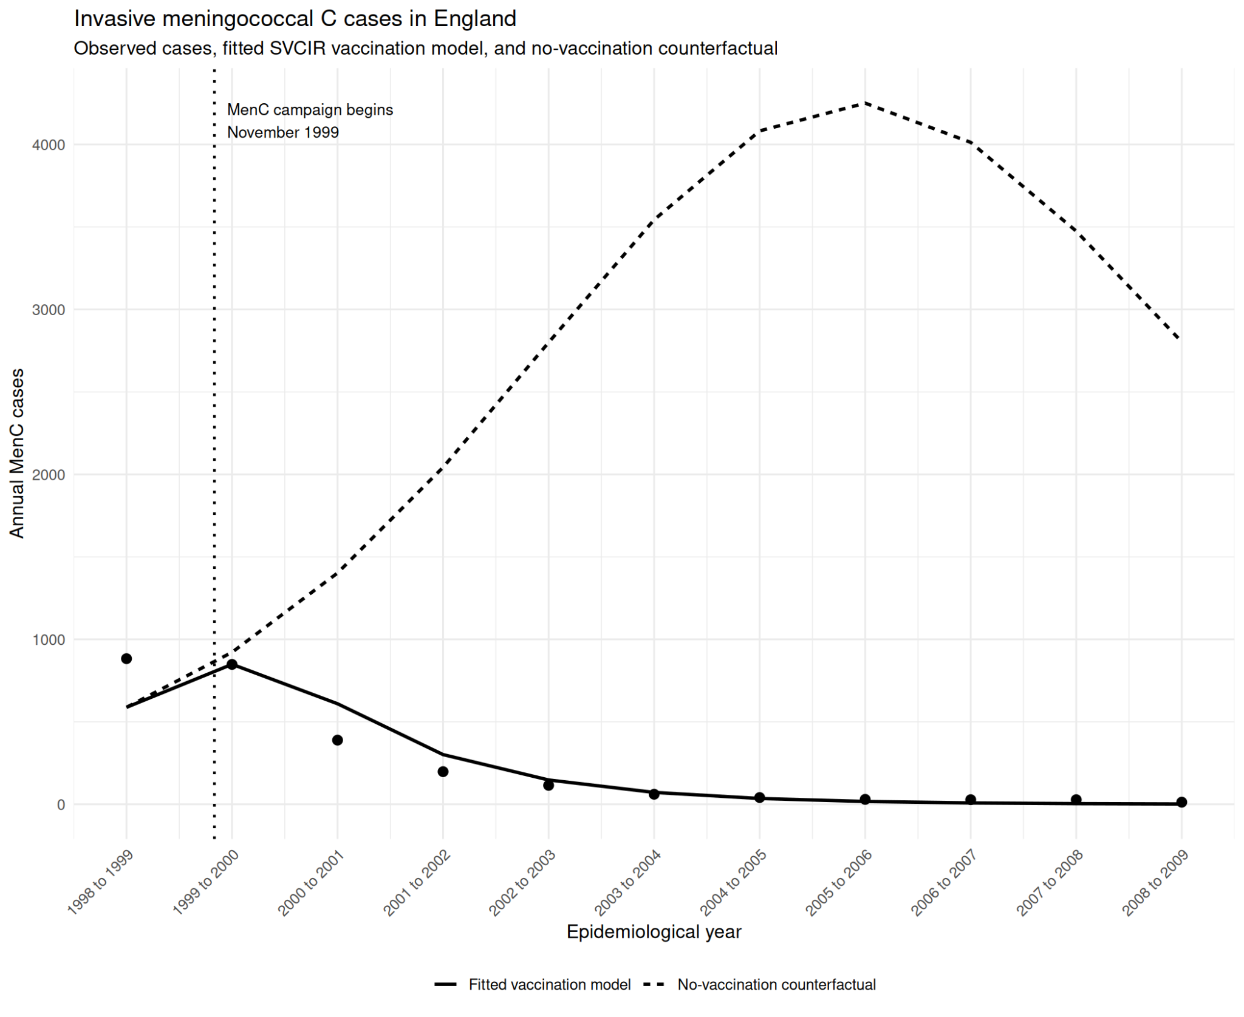
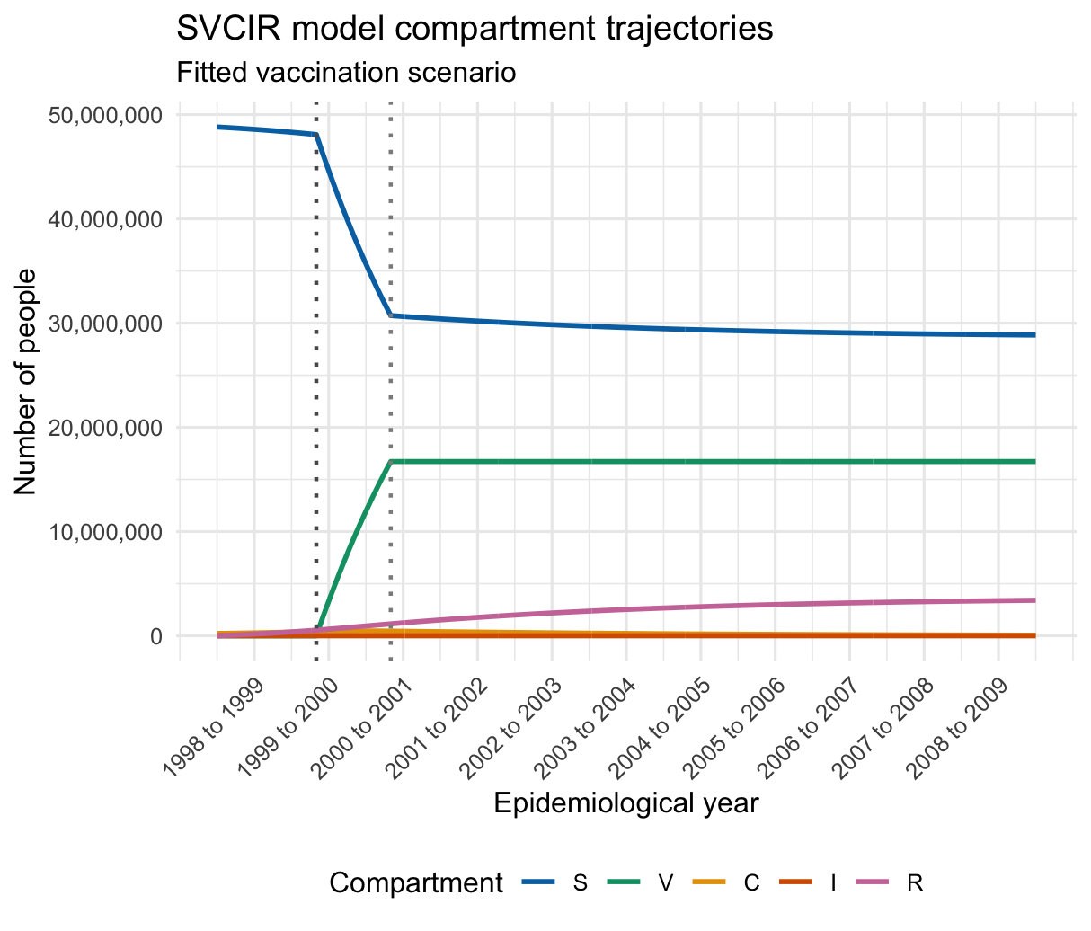
Modelling the impact of the MenC vaccination programme
References and Appendix
Sara Althaqafi

Slide 7
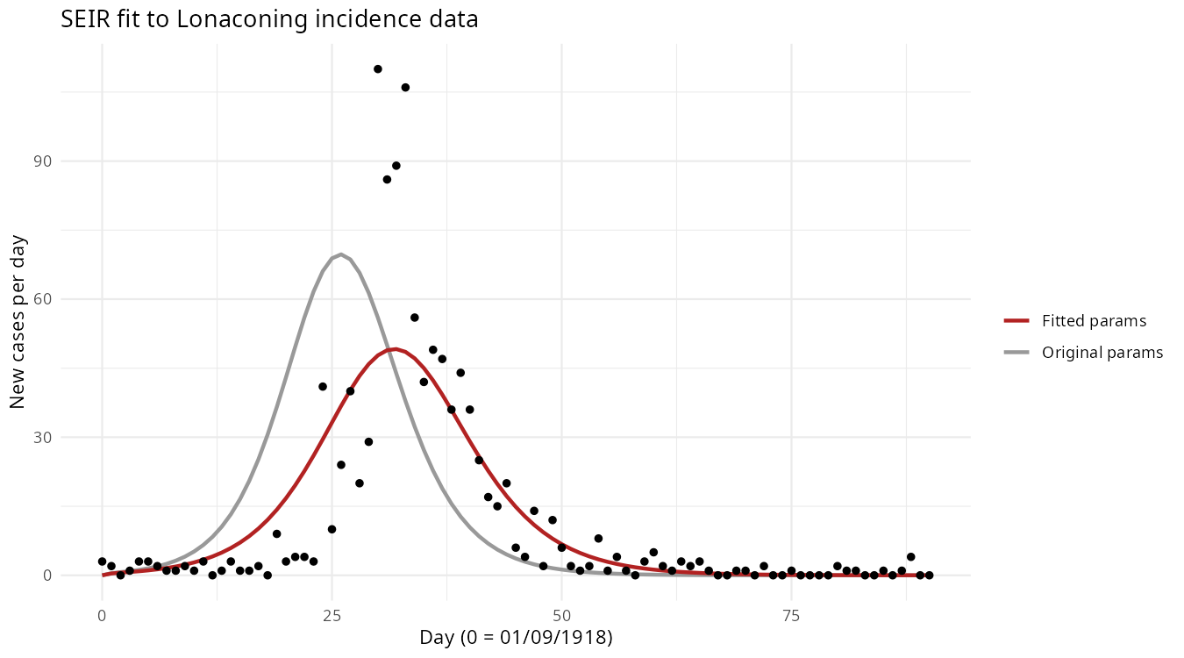
Mada: How Hypothetical Vaccination Could Reshapes the 1918 Lonaconing Flu Outbreak
Explore the data
Build and optimize the model
Stimulate hypothetical model for vaccination
Methods
Selected Lonaconing as the case study because it had the highest infection rate
Applied an SEIR model to simulate the outbreak.
Model parameters (R₀= 2.5, incubation period= 1.9 days, and infectious period = 1.4 days) were obtained from the literature.
Used R’s optim() function to estimate the transmission rate (β) by fitting the model to the observed case data.
Nishiura H. Early efforts in modeling the incubation period of infectious diseases with an acute course of illness. PLoS One. 2008;3(1):e1498. doi:10.1371/journal.pone.0001498.

Slide 8
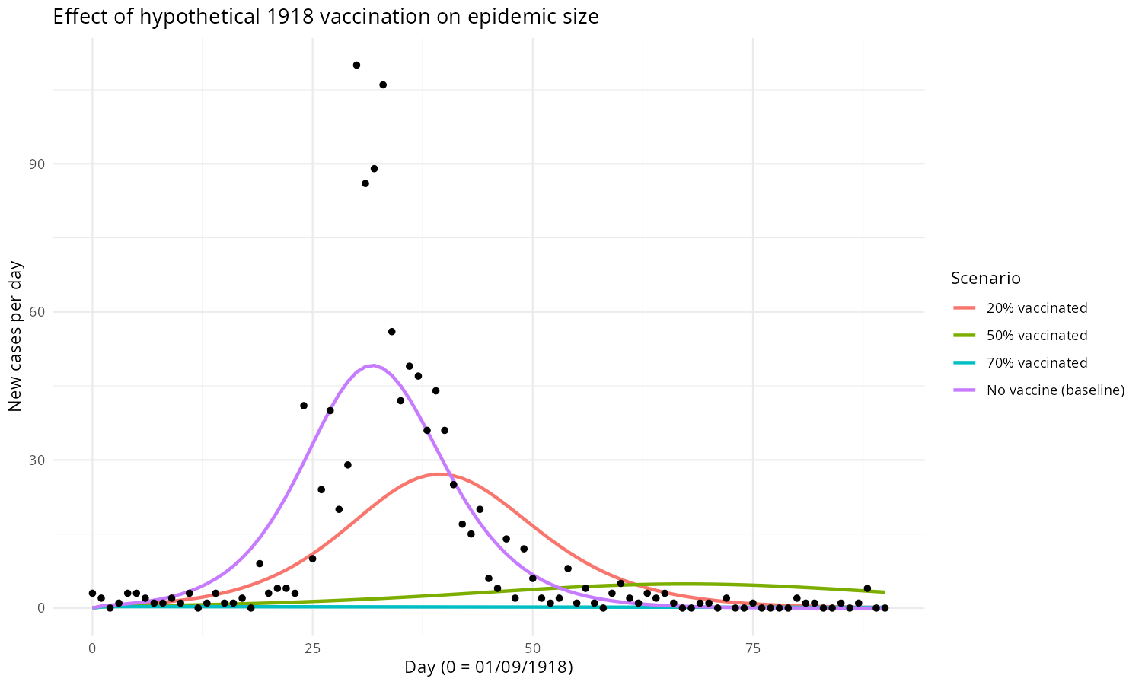
Mada: How Hypothetical Vaccination Could Reshapes the 1918 Lonaconing Flu Outbreak
Results
Literature-based parameters alone underestimated the outbreak's peak, but after calibrating β with optim, the model closely matched Lonaconing real data.
At 20% vaccine coverage, the outbreak decrease but still occurred.
At 50% coverage, total immunity crossed the herd immunity threshold (~45%), which would have prevented the outbreak almost entirely.

Slide 9
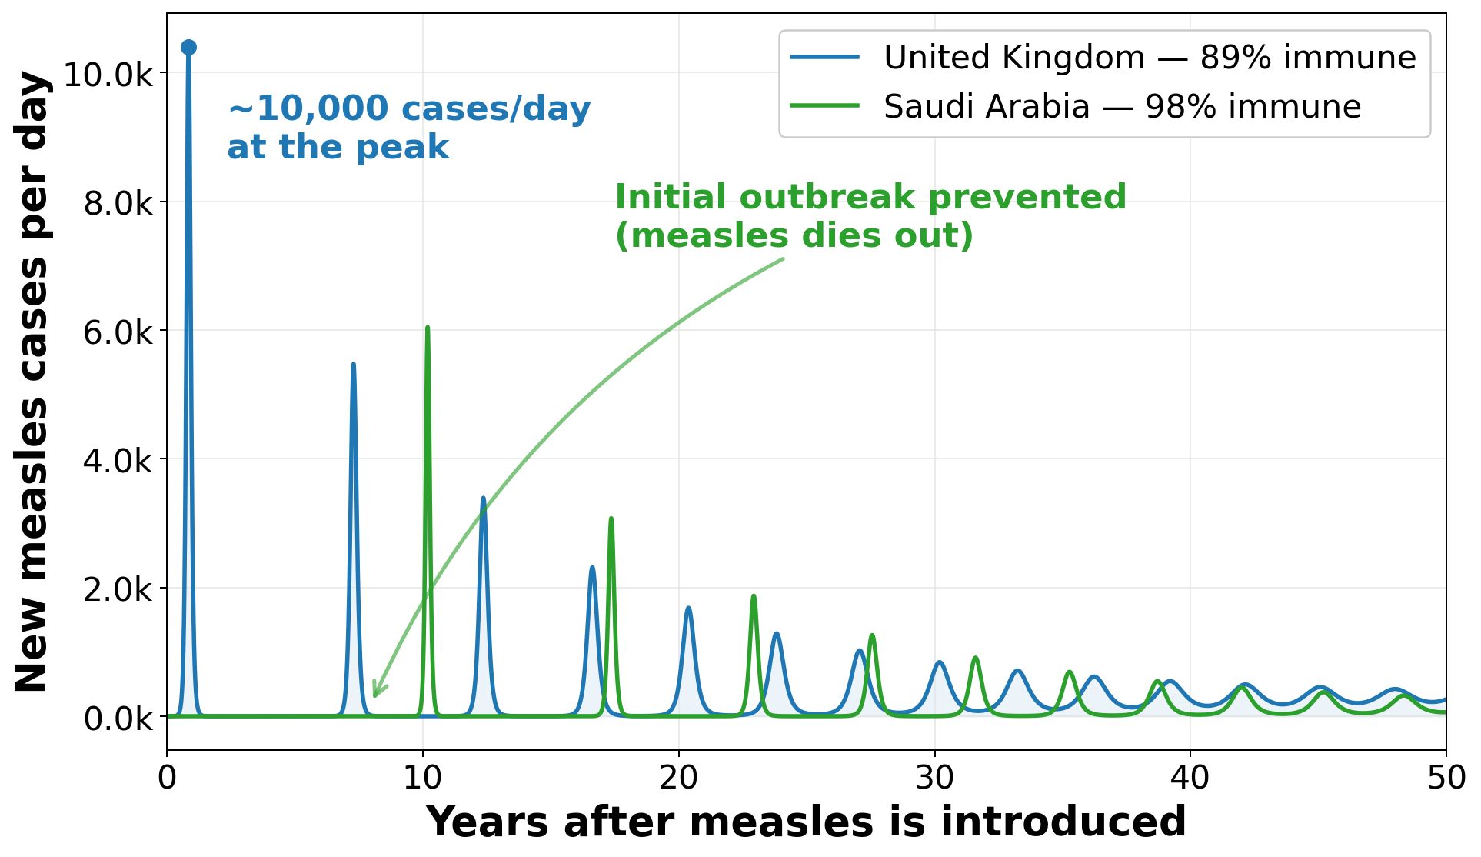
Ryan: Comparative SEIR Modeling of Measles: UK & Saudi Arabia
How sensitive are measles outbreaks to small differences in vaccination coverage?
WHAT I DID
Built an SEIR model with births/deaths and a vaccinated compartment for each country, seeded one case, and simulated 50 years. UK 89% immune (R₀ 15); Saudi Arabia 98% immune (R₀ 13).
RESULT
Immunity below the ~93% herd threshold is decisive. At 89% the UK erupts to ~10,000 cases/day, then recurring waves. At 98% Saudi Arabia's introduction fizzles out.
Now real: UK lost WHO measles elimination status in 2026; MMR uptake ~89% — the modeled scenario.
Parameters: σ=1/8 d (latent), γ=1/5 d (infectious), R₀=15 UK/13 SA, β=R₀(σ+μ)(γ+μ)/σ ≈ 3.0 UK / 2.6 SA, μ=1/82 yr ≈ 3.3×10⁻⁵ UK / 1/76 yr ≈ 3.6×10⁻⁵ SA, ψ=1×10⁻⁵ baseline (0.2% d⁻¹ in campaign), ρ=0.15 reporting, N= 66,805,830 UK / 30,906,342 SA Population.
Sources: Guerra et al., R₀ of measles: a systematic review, Lancet Infect Dis 2017;17:e420–28 · WHO/UNICEF measles vaccination coverage (WIISE), GBR & SAU
Notes:
(~30 sec)
Comparative SEIR Modeling of Measles: UK & Saudi Arabia
Most contagious disease: 1 case infects 12 to 18 people.
Herd-Immunity Vac: Only way to prevent the outbreak.
The reality check: UK lost its WHO measles-elimination status this year (2026).
The trigger: UK MMR coverage slipped to 89% (lowest in a decade).
The core question: How sensitive are measles outbreaks to small differences in vaccination coverage?
(~2 min)
Model Structure:
Plain SIR not enough. Added E (Exposed) for the 8-day latent period.
Added vital dynamics (births/deaths) and a V (Vaccinated) compartment for a 50-year run.
Crucial detail: Births constantly refill the susceptible pool, driving recurring waves rather than a single burnout.
Parameters:
Infectious period: 5 days.
R0: 15 for UK, 13 for Saudi Arabia.
Population: 67 million (UK), 31 million (SA).
Assumed 15% reporting rate.
The Result (Under the model assumptions):
Blue line (UK): Starts at 89% immunity (just below 93% threshold) -> Explodes to **10,000 cases/day** and settles into repeating waves.
Green line (SA): Starts at 98% immunity -> Epidemic fizzles out immediately.
Takeaway: A few percentage points make the entire difference.

Slide 10
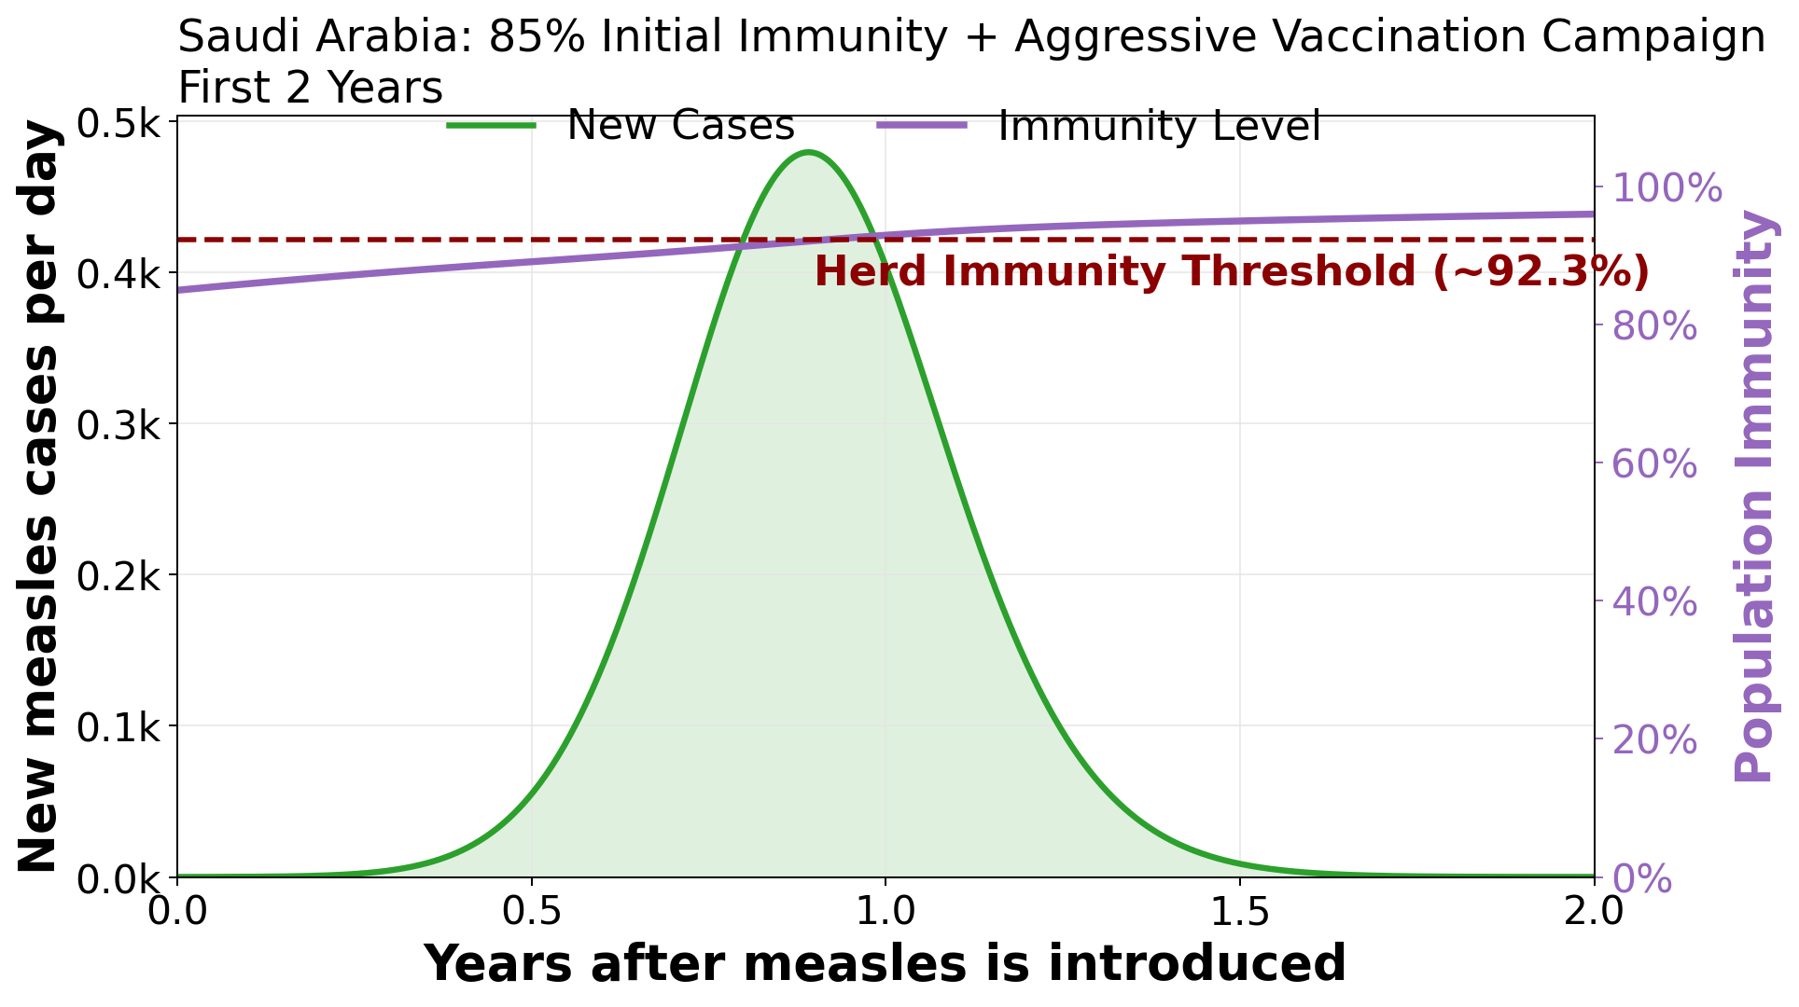
Ryan: Comparative SEIR Modeling of Measles: UK & Saudi Arabia
Can a below-threshold country still stop measles by vaccinating fast?
WHAT I DID
Started Saudi Arabia at only 85% immunity — below the herd threshold — then switched on an aggressive rolling campaign (0.2% of susceptibles/day) and tracked cases vs population immunity.
RESULT
One outbreak still happens (peak ~480 cases/day near year 1), but the campaign pushes immunity past the 92.3% threshold within a year — driving cases back to zero, no second wave.
Parameters: σ=1/8 d (latent), γ=1/5 d (infectious), R₀=15 UK/13 SA, β=R₀(σ+μ)(γ+μ)/σ ≈ 3.0 UK / 2.6 SA, μ=1/82 yr ≈ 3.3×10⁻⁵ UK / 1/76 yr ≈ 3.6×10⁻⁵ SA, ψ=1×10⁻⁵ baseline (0.2% d⁻¹ in campaign), ρ=0.15 reporting, N= 66,805,830 UK / 30,906,342 SA Population.
Sources: Guerra et al., R₀ of measles: a systematic review, Lancet Infect Dis 2017;17:e420–28 · WHO/UNICEF measles vaccination coverage (WIISE), GBR & SAU
Notes:
(~1.5 min)
The Scenario: Dropped Saudi Arabia to 85% immunity (below threshold).
The Intervention: Activated a rolling campaign vaccinating 0.2% of susceptibles daily.
The Graph:
Purple = population immunity. Green = new cases. Red dashed = herd threshold (92.3%).
The Result:
You get one outbreak peaking at ~480 cases/day.
Within a year, the campaign pushes immunity past the 92.3% threshold.
Cases collapse to zero. No second wave.
Takeaway: Starting below the threshold guarantees one outbreak, but fast vaccination converts it into permanent control.
(~20 sec)
Summary: Measles requires SEIR + births for realism. Our model shows how a small difference in vaccination coverage—less than 10 percentage—can shift to recurrent outbreaks. (Simulate the outbreak and not a forcasting model).
Model Limitations: It assumes homogeneous mixing, no age structure or specific groups in the population (London outbreaks mostly).

Slide 11
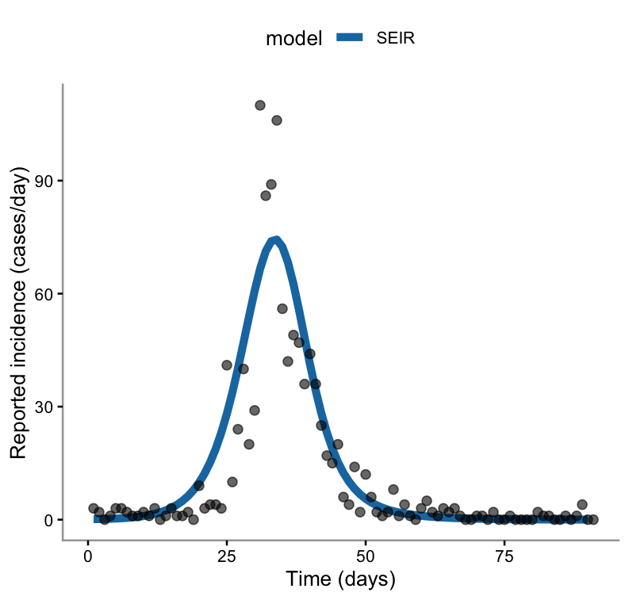
Under-reporting and the fragility of R₀
Lonaconing - Maryland
Single epidemic wave, ~1,093 reported cases in a population of 1,840
SEIR model + reporting fraction ρ → predicts reported incidence
Fixed: 1/σ = 2 days, 1/γ = 7 days (γ = 0.14)
Estimated by optim(): β = 0.560, ρ = 0.67
Jilani TN, Jamil RT, Nguyen AD, et al. H1N1 Influenza. [Updated 2024 Mar 4]. In: StatPearls [Internet]. Clinicaltrials.eu. (n.d.). H1N1 influenza – Life with disease. Retrieved July 16, 2026.
Hanyn A. Alturki

Slide 12
Under-reporting and the fragility of R₀
Missing a third of cases: R₀ goes from 1.52 to 2.46 (+62%). Herd immunity threshold: 34% → 59%.
But 2.46 is still not 4.00. To reach 4.00, ρ would need to be 0.61 — only 6 points below my 0.67. A tiny change in ρ closes the whole gap.
The formula is unstable when nearly everyone is infected. Here the corrected attack rate is already 89% — so close to 100% that it cannot tell R₀ = 2.5 from R₀ = 4.
Two ways to get R₀: mechanistic (β/γ) vs final size (−log(1−r)/r)
Method | R₀ | Herd immunity threshold
Final size, reported cases | 1.52 | 34%
Final size, corrected for ρ | 2.46 | 59%
SEIR fit (β/γ) | 4.00 | 75%
β and ρ fitted jointly to the same data — sensitivity analysis, not independent validation.
Hanyn A. Alturki

Slide 13
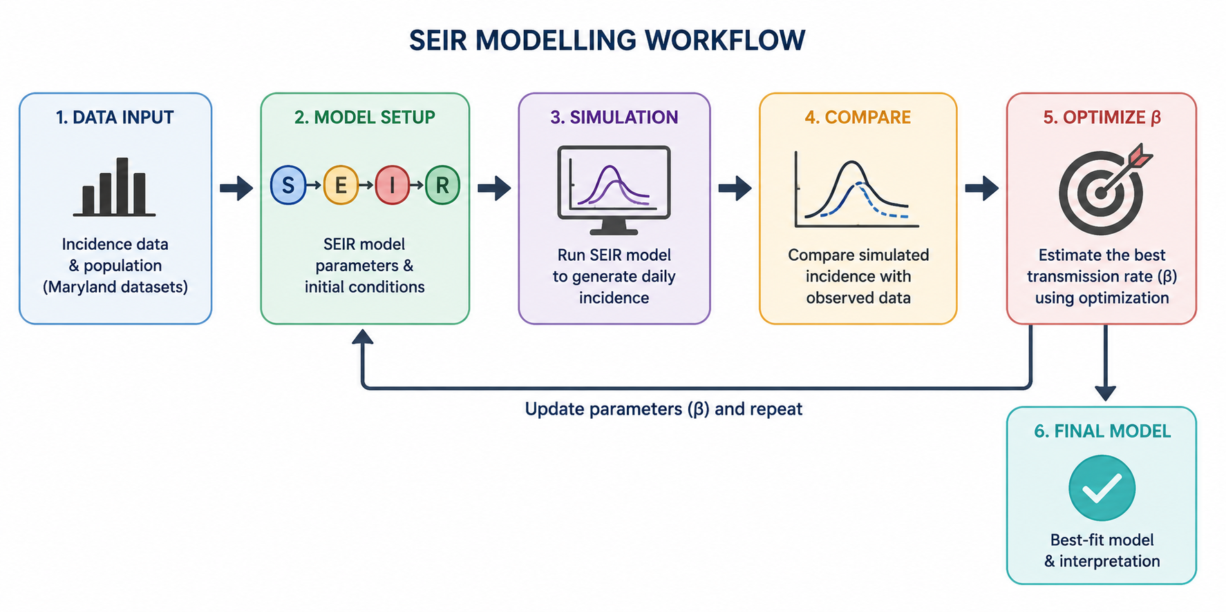
Decoding the Baltimore 1918 Influenza Pandemic: A SEIR Modelling Approach
Methodology
SEIR model was applied to capture influenza’s latent period.
Historical outbreak data were used to drive model simulations.
Model optimization was performed to improve model fit.
Vaccination scenarios were explored to assess potential intervention strategies.
Turky AlSulaiman

Slide 14
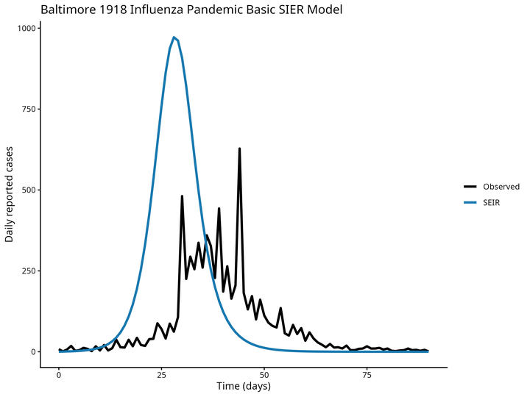
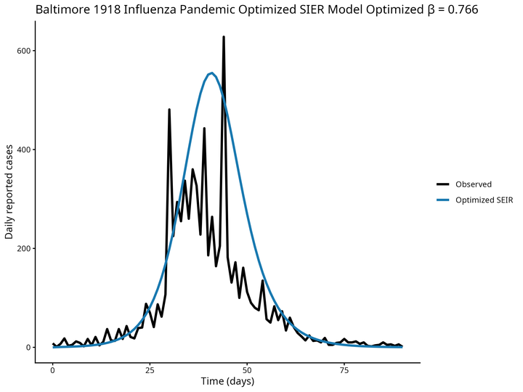
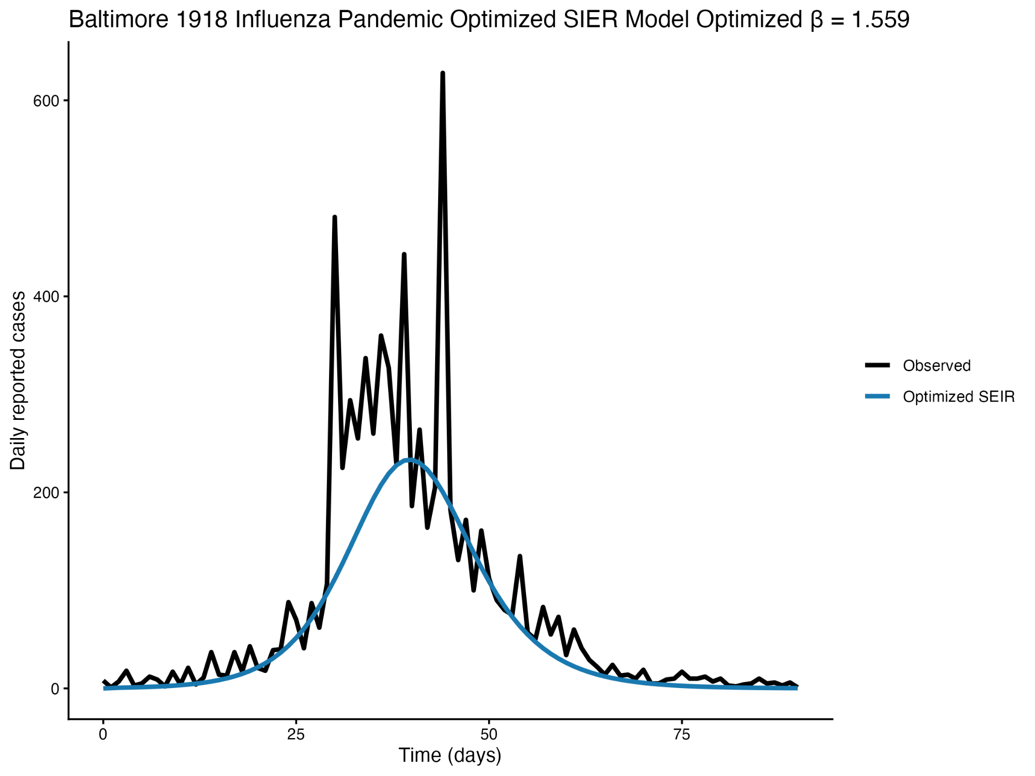
Decoding the Baltimore 1918 Influenza Pandemic: A SEIR Modelling Approach
Parameters: β = 1.00 | Immunity = 15%
Early, sharp epidemic peak.
Poor agreement with observed data.
Parameters: β = 0.766 | Immunity = 15%
Improved fit after model optimization.
Better matched the observed epidemic.
Parameters: β = 1.559 | Immunity = 60%
Reduced epidemic size.
Illustrates the effect of vaccination.
Reporting probability (ρ): 0.5, Latent rate (σ): 1 day , Recovery rate (γ): 3 days, Initial exposed (E₀): 0, Initial infectious (I₀): 3
Turky AlSulaiman

Slide 15
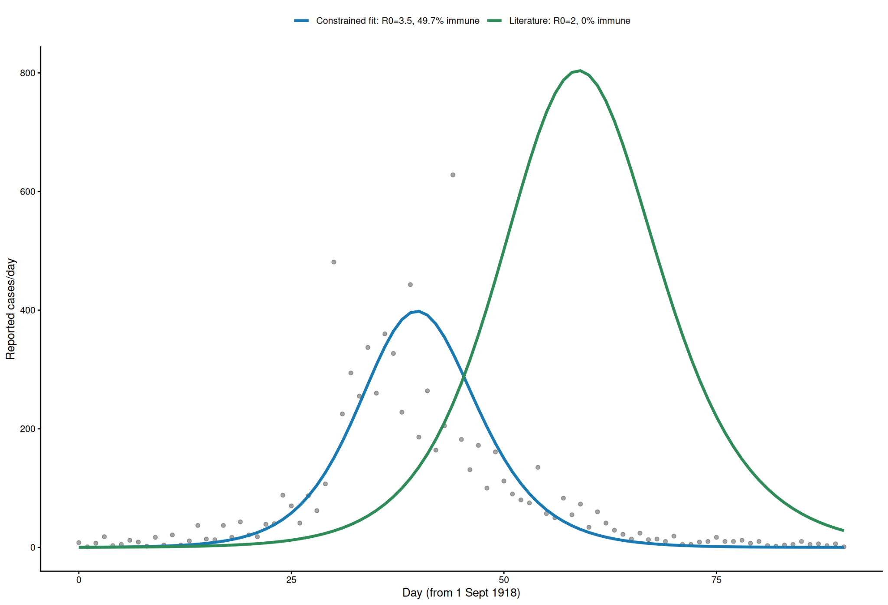
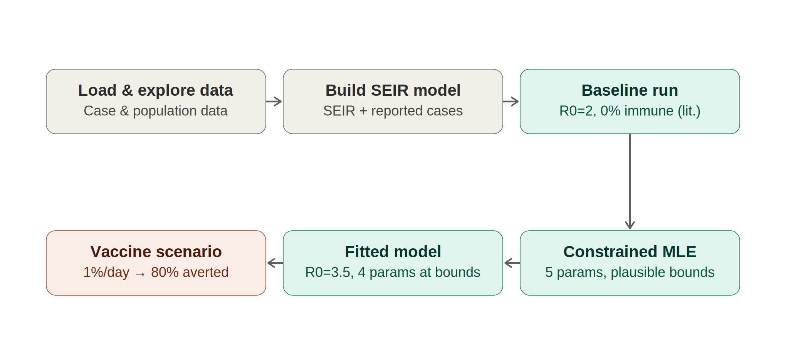
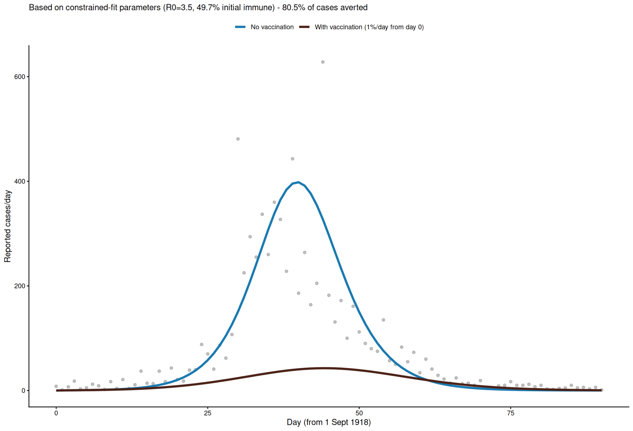
How well can a standard SEIR model explain Baltimore's 1918 influenza outbreak, and what would a vaccine have changed?
Dalia Almasud
What i did:
Results • Literature-average parameters (R0≈2) failed to match the outbreak's timing; the best fit within realistic bounds required R0≈3.5, along with a 1-day incubation period, 2-day infectious period, and ~49.7% initial immunity; all pushed to the edge of what's plausible for influenza
• Under this fitted epidemic, an idealized day-0 vaccination campaign would have averted about 80% of cases. HIT was 71.4%.

Slide 16
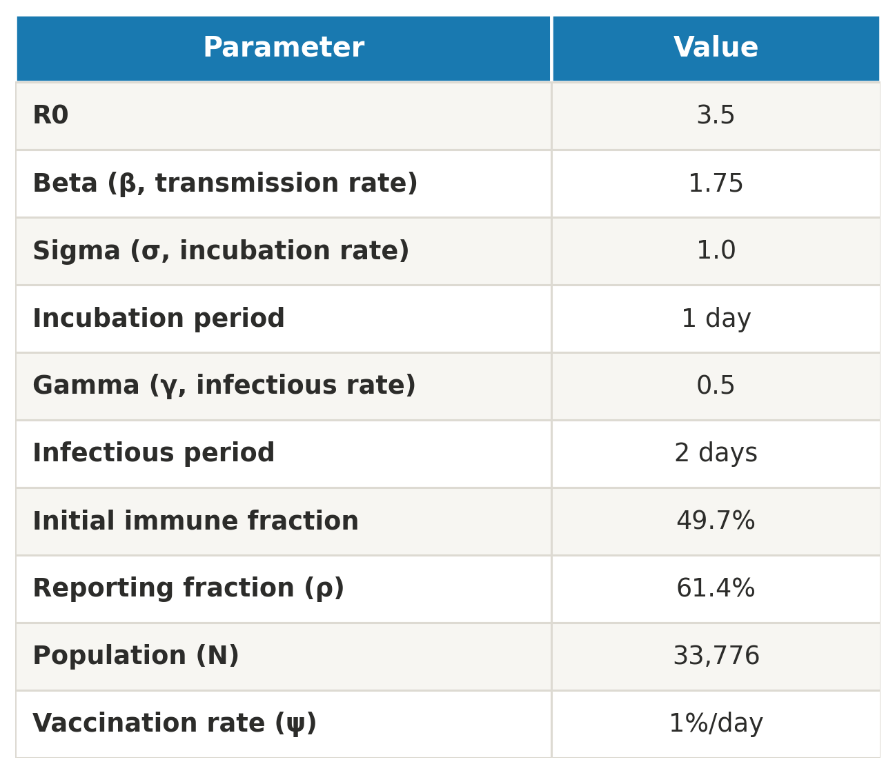
How well can a standard SEIR model explain Baltimore's 1918 influenza outbreak, and what would a vaccine have changed?
Dalia Almasud
Difficulties: estimating the reporting fraction. In an earlier attempt, when I let R0 search freely without a realistic cap, the reporting fraction kept climbing to 100%, the maximum possible, which isn't a real answer. Once I capped R0 to a realistic range in my final model, the reporting fraction settled at a sensible value, 61.4%. This showed me that R0 and the reporting fraction were pulling against each other, and putting realistic limits on R0 fixed the problem.
Also, my ears were blocked this week and I couldn't hear things clearly :) (good news, i went for a clean up yesterday and now i’m alright :D)
Next step: Use age-stratified data (Table VI/VII) to test whether concentrating immunity in older cohorts fits without needing such an extreme R0

Slide 17
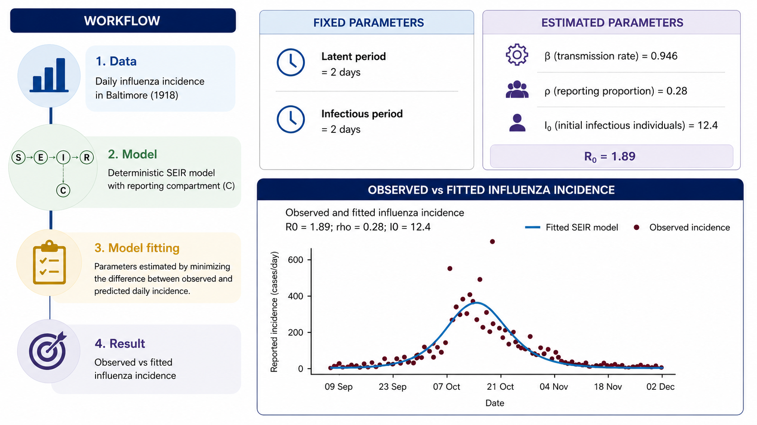
How would reducing influenza transmission have altered the 1918 Baltimore epidemic?
Lames Baraji

Slide 18
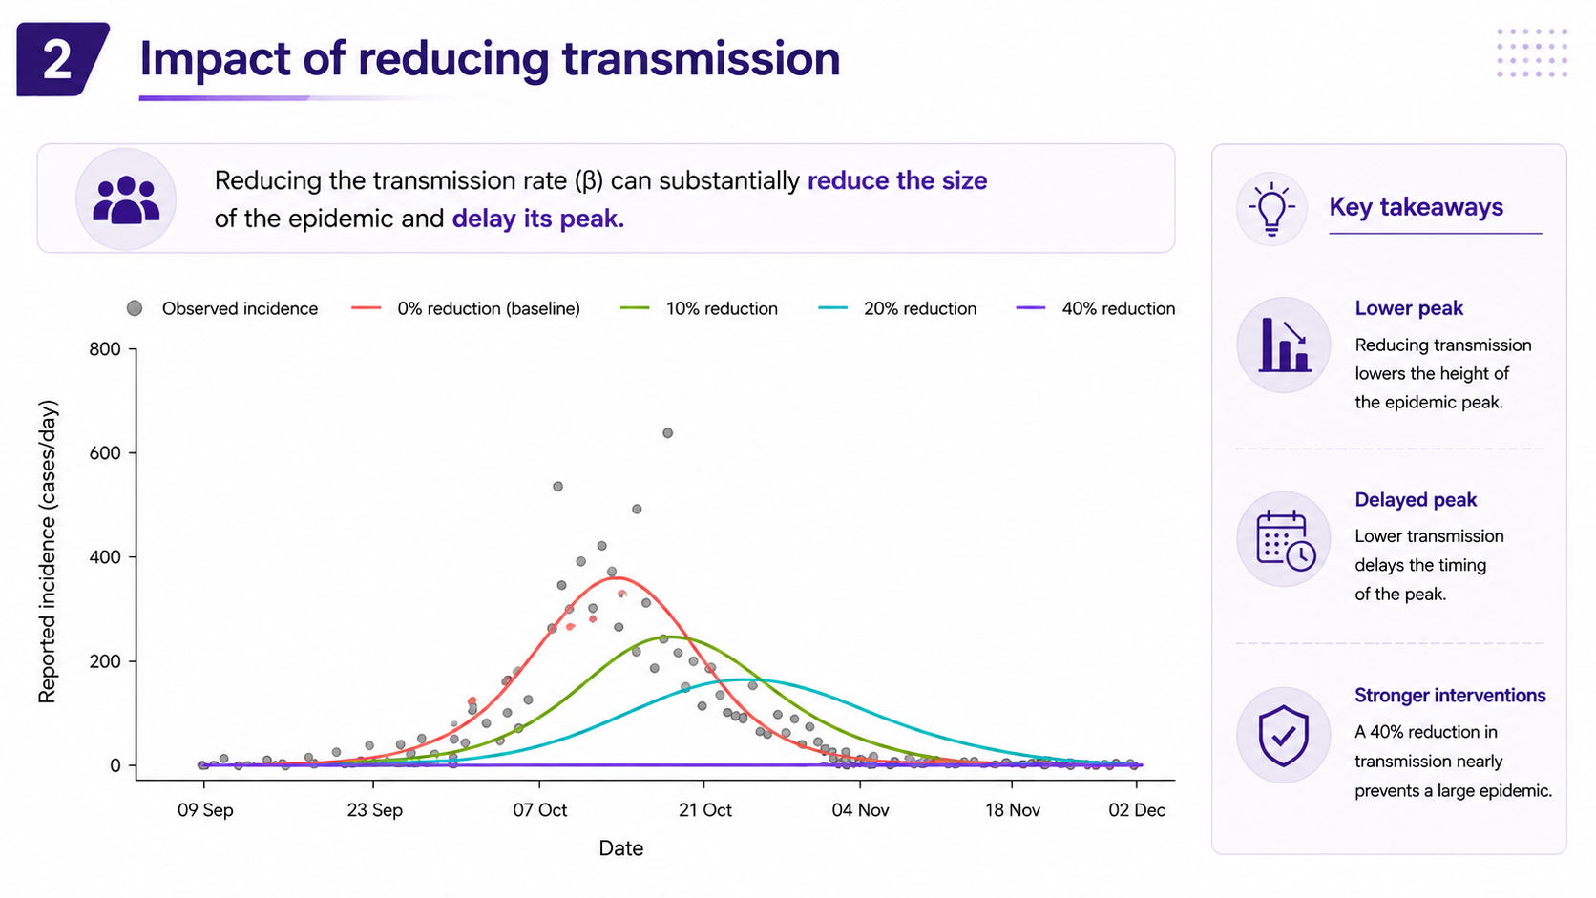
How would reducing influenza transmission have altered the 1918 Baltimore epidemic?
Lames Baraji

Slide 19
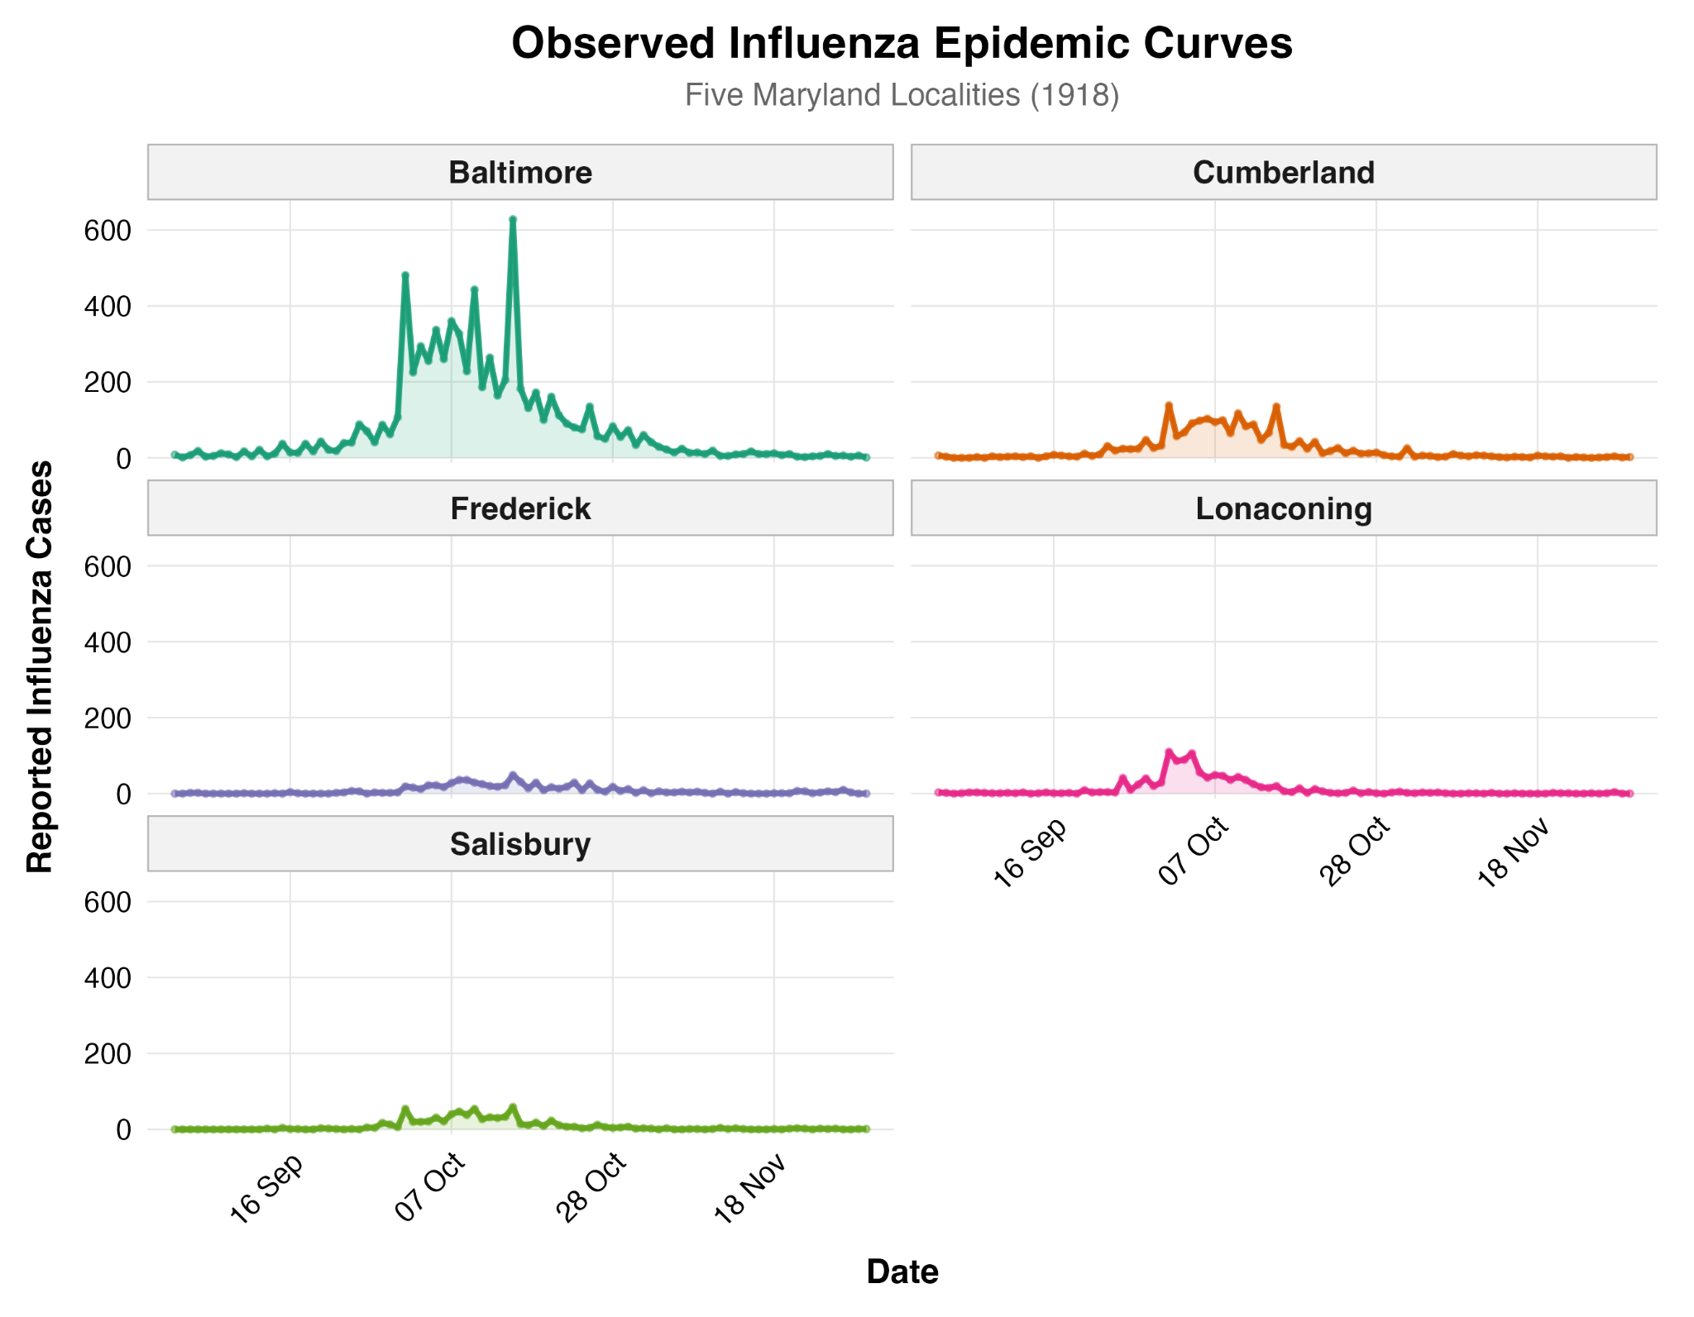
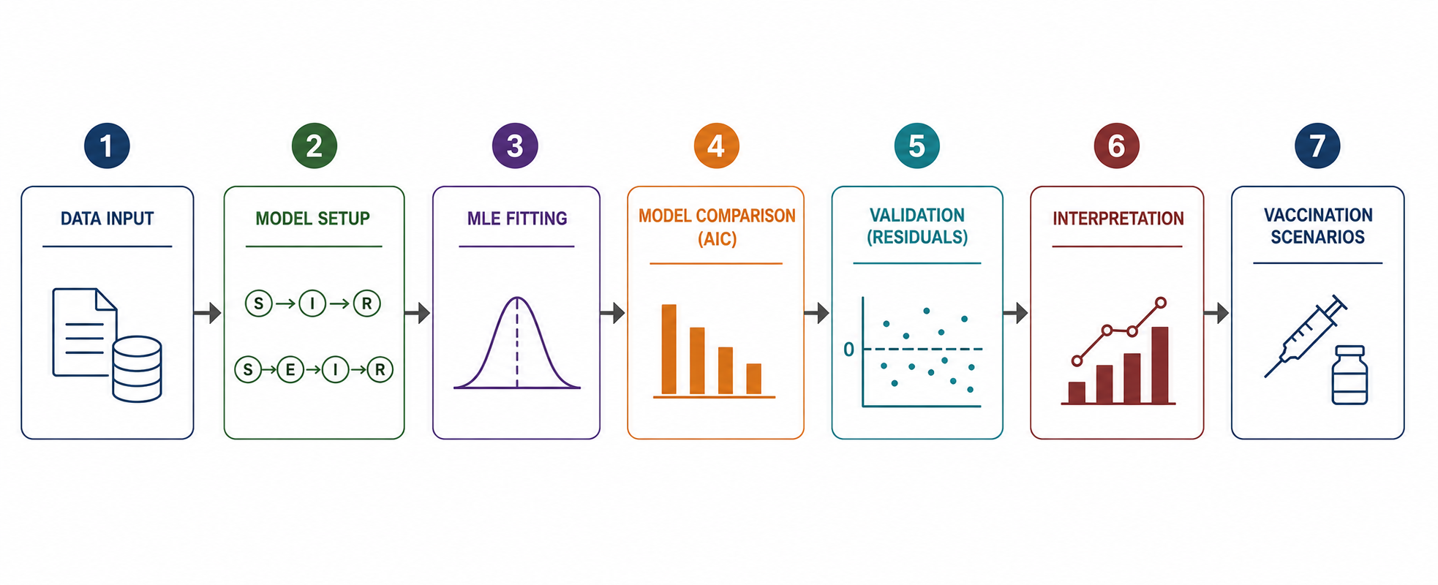
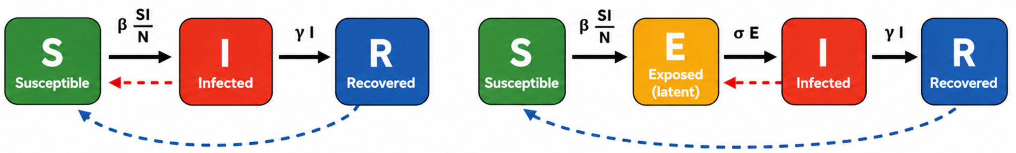
How well can SIR and SEIR models reproduce the 1918 influenza epidemic across five Maryland localities, and what can they tell us about epidemic dynamics and hypothetical vaccination?
Objectives:
1) Which compartmental structure SIR or SEIR best explains the observed epidemics?
2) What transmission parameters (β, γ, σ, R₀) does the data itself support?
3) Do the fitted models show any systematic lack of fit?
4) How did epidemic dynamics differ across five localities of very different size?
5) What vaccination coverage would have been needed to stop each outbreak?
Methodology:
Models:
Figure: Daily influenza incidence in five Maryland localities during the 1918 pandemic. Baltimore experienced the largest outbreak, while the remaining localities showed smaller epidemics with similar temporal patterns.
Fadia Ashmawi

Slide 20
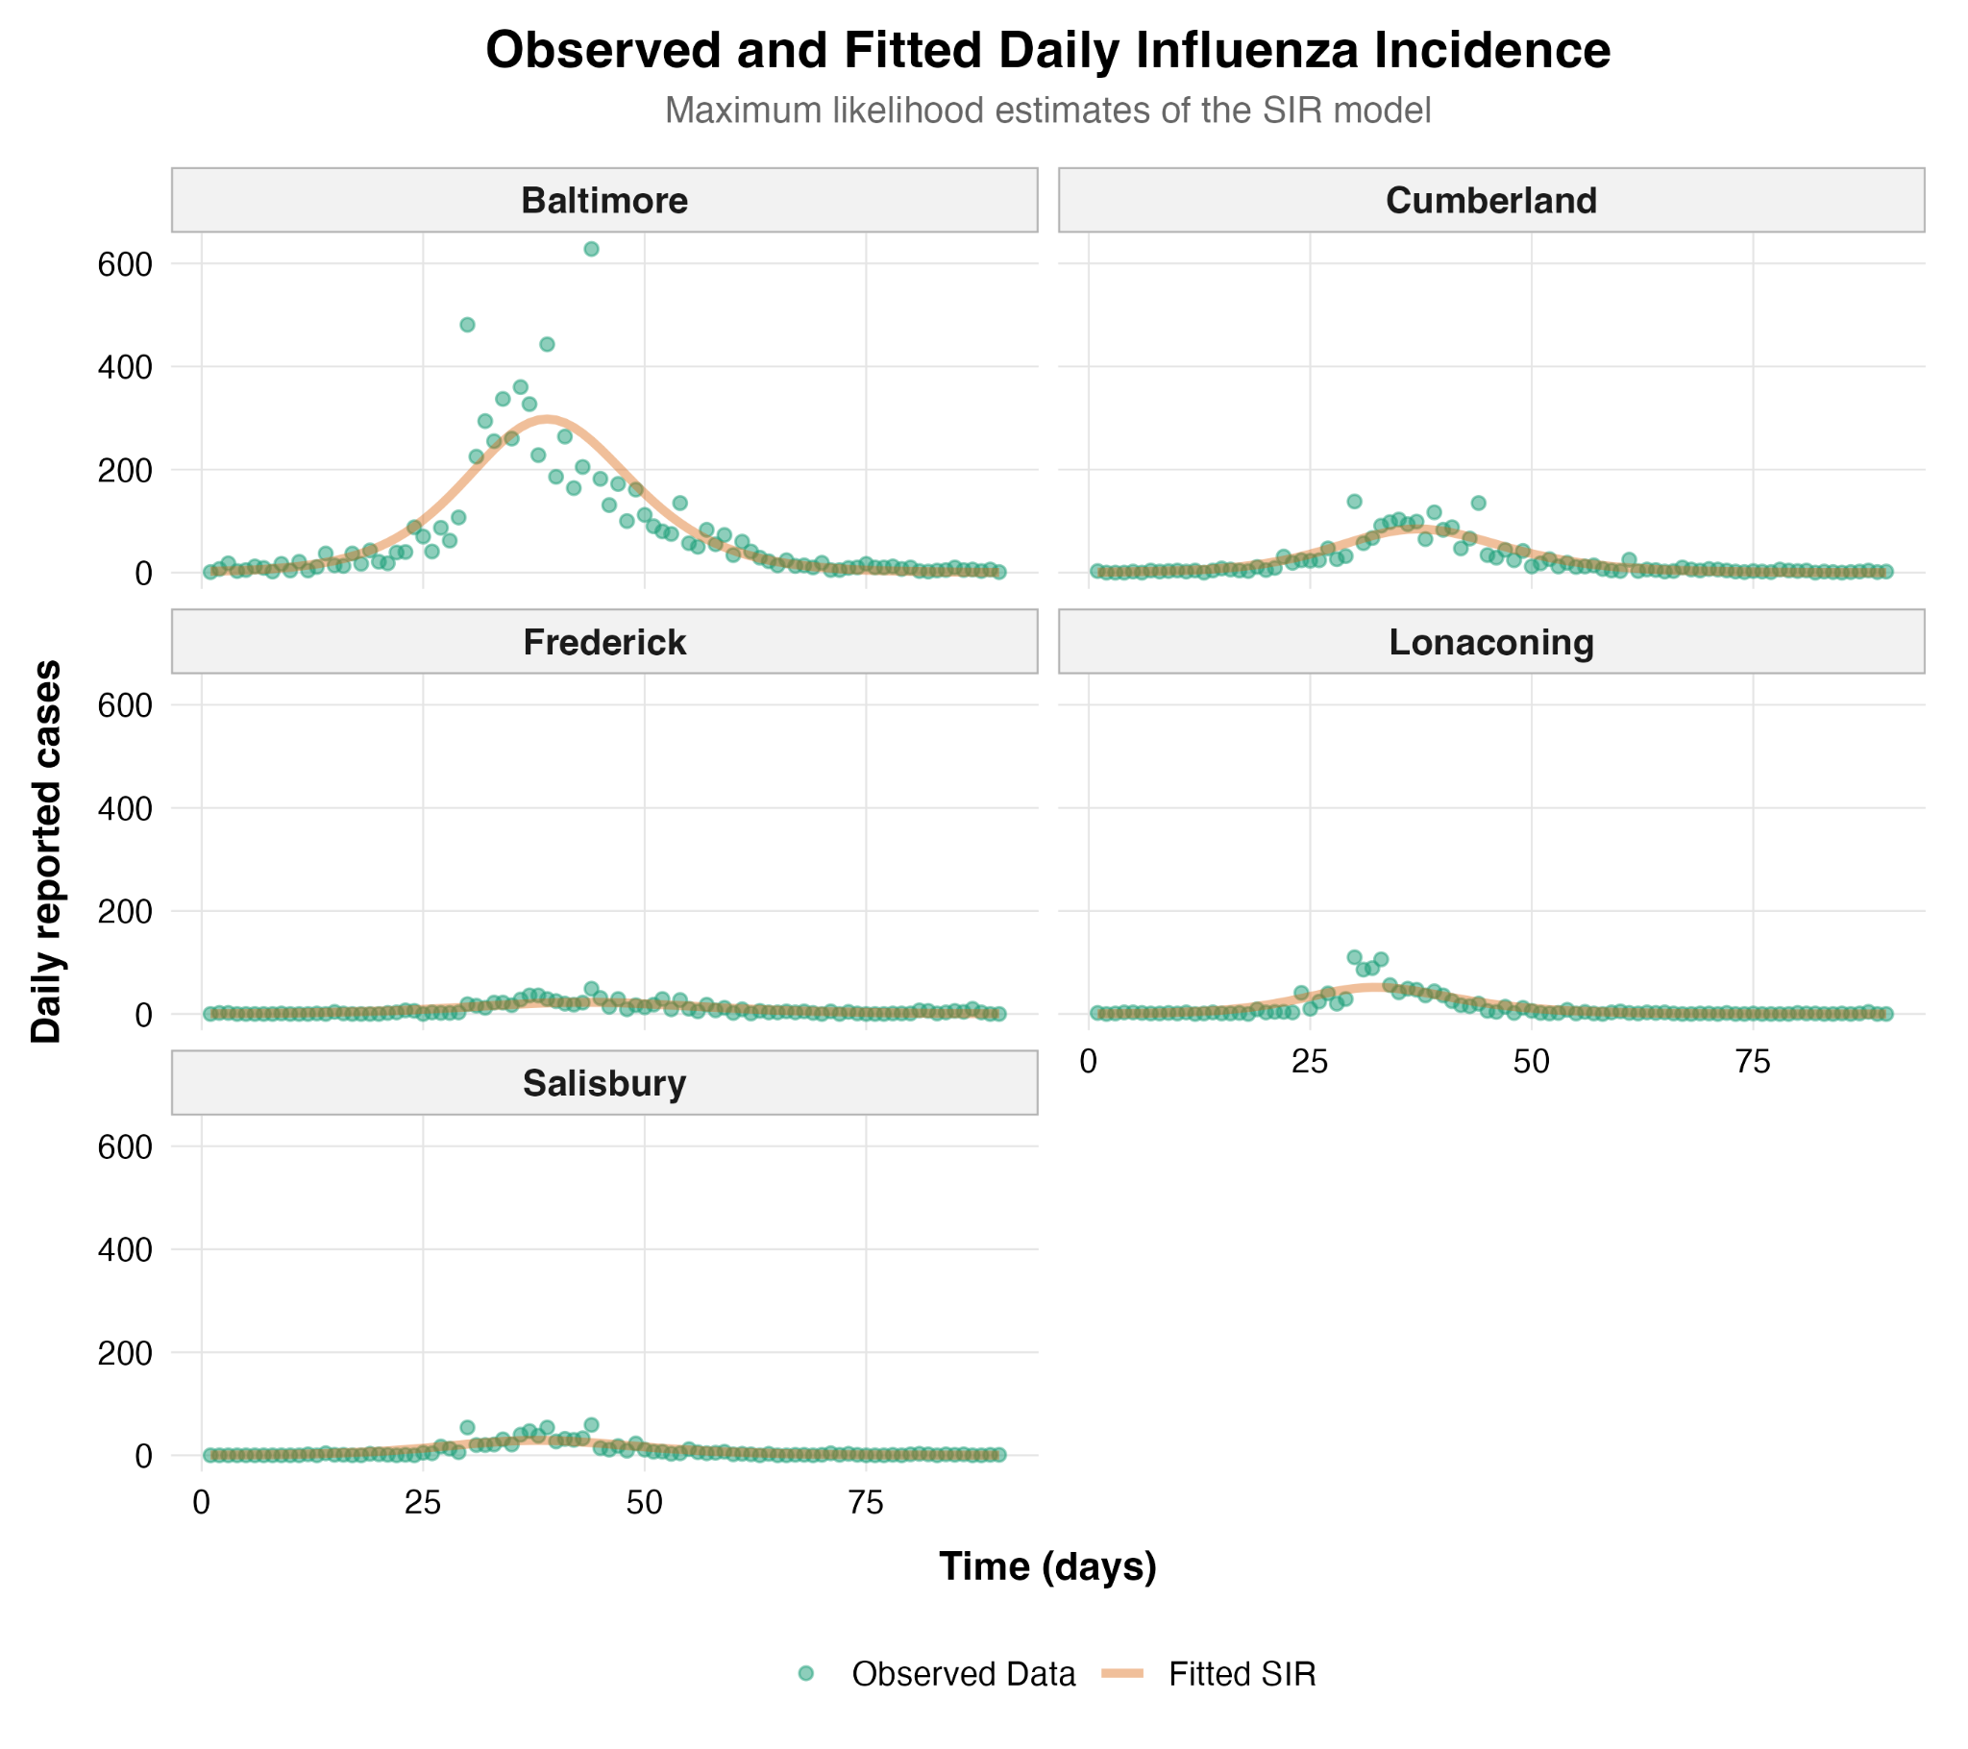
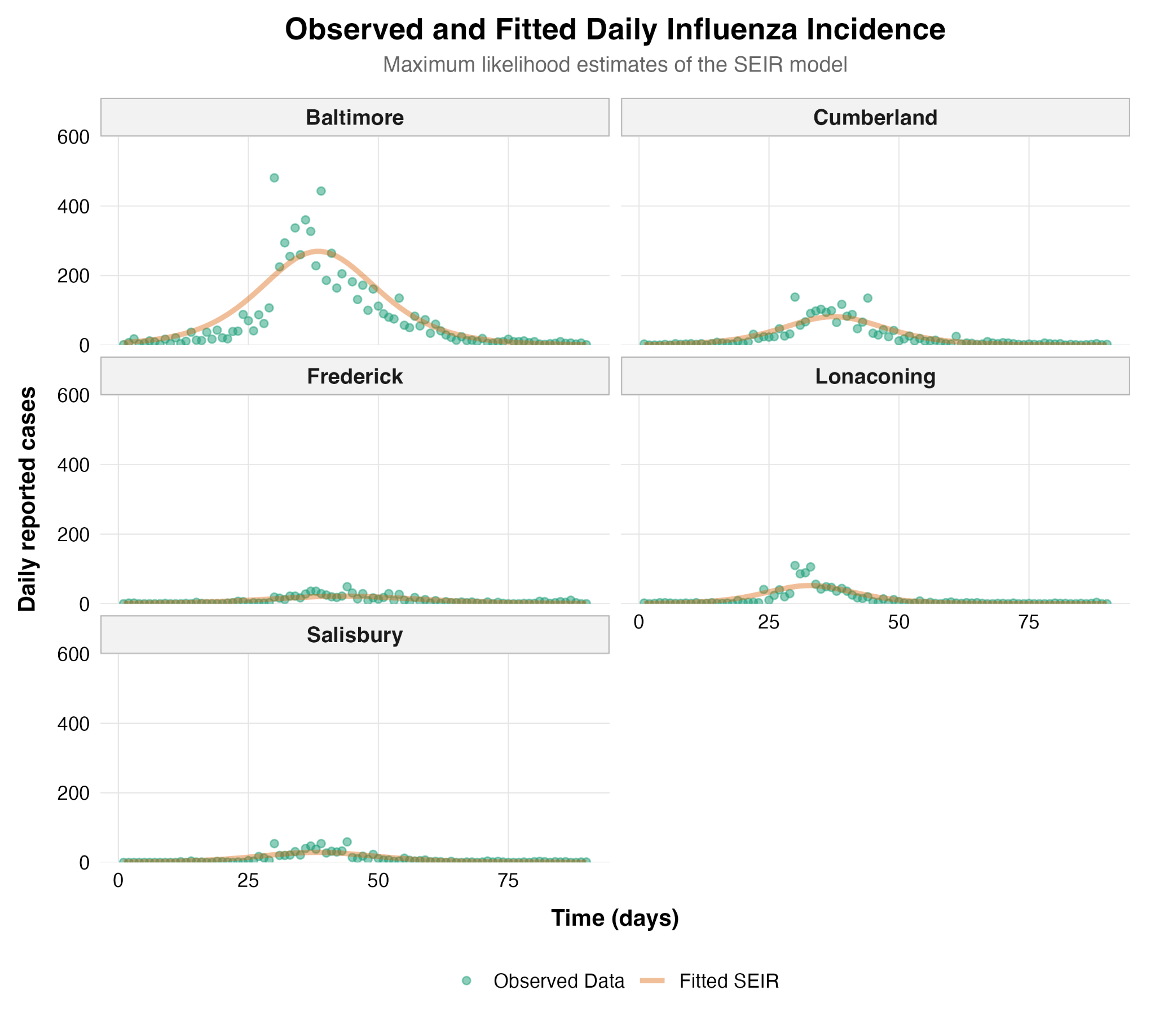
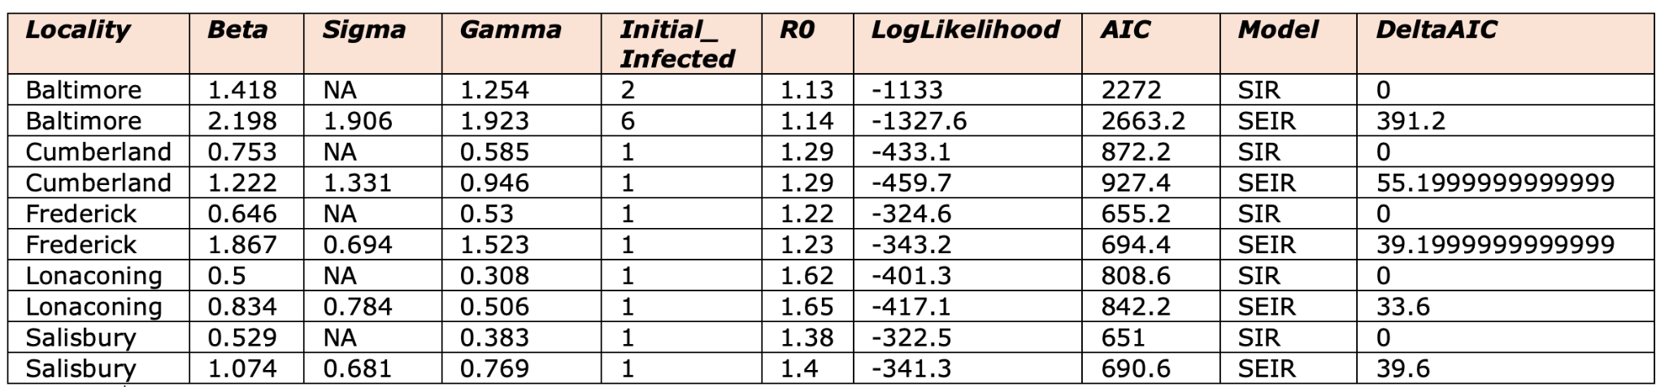
How well can SIR and SEIR models reproduce the 1918 influenza epidemic across five Maryland localities, and what can they tell us about epidemic dynamics and hypothetical vaccination?
How well can SIR and SEIR models reproduce the 1918 influenza epidemics across five Maryland localities?
What I did: Fit both SIR and SEIR by maximum likelihood to all five localities and compared them by log-likelihood and AIC.
Results: Both models recovered nearly identical R₀ (≤0.03 apart) and matched the timing/scale of each outbreak, but SIR had both higher log-likelihood and lower AIC everywhere (ΔAIC 33.6–391.2) — since SEIR nests SIR, a worse likelihood despite more flexibility points to optimizer non-convergence rather than latent structure being unhelpful.
Fadia Ashmawi

Slide 21
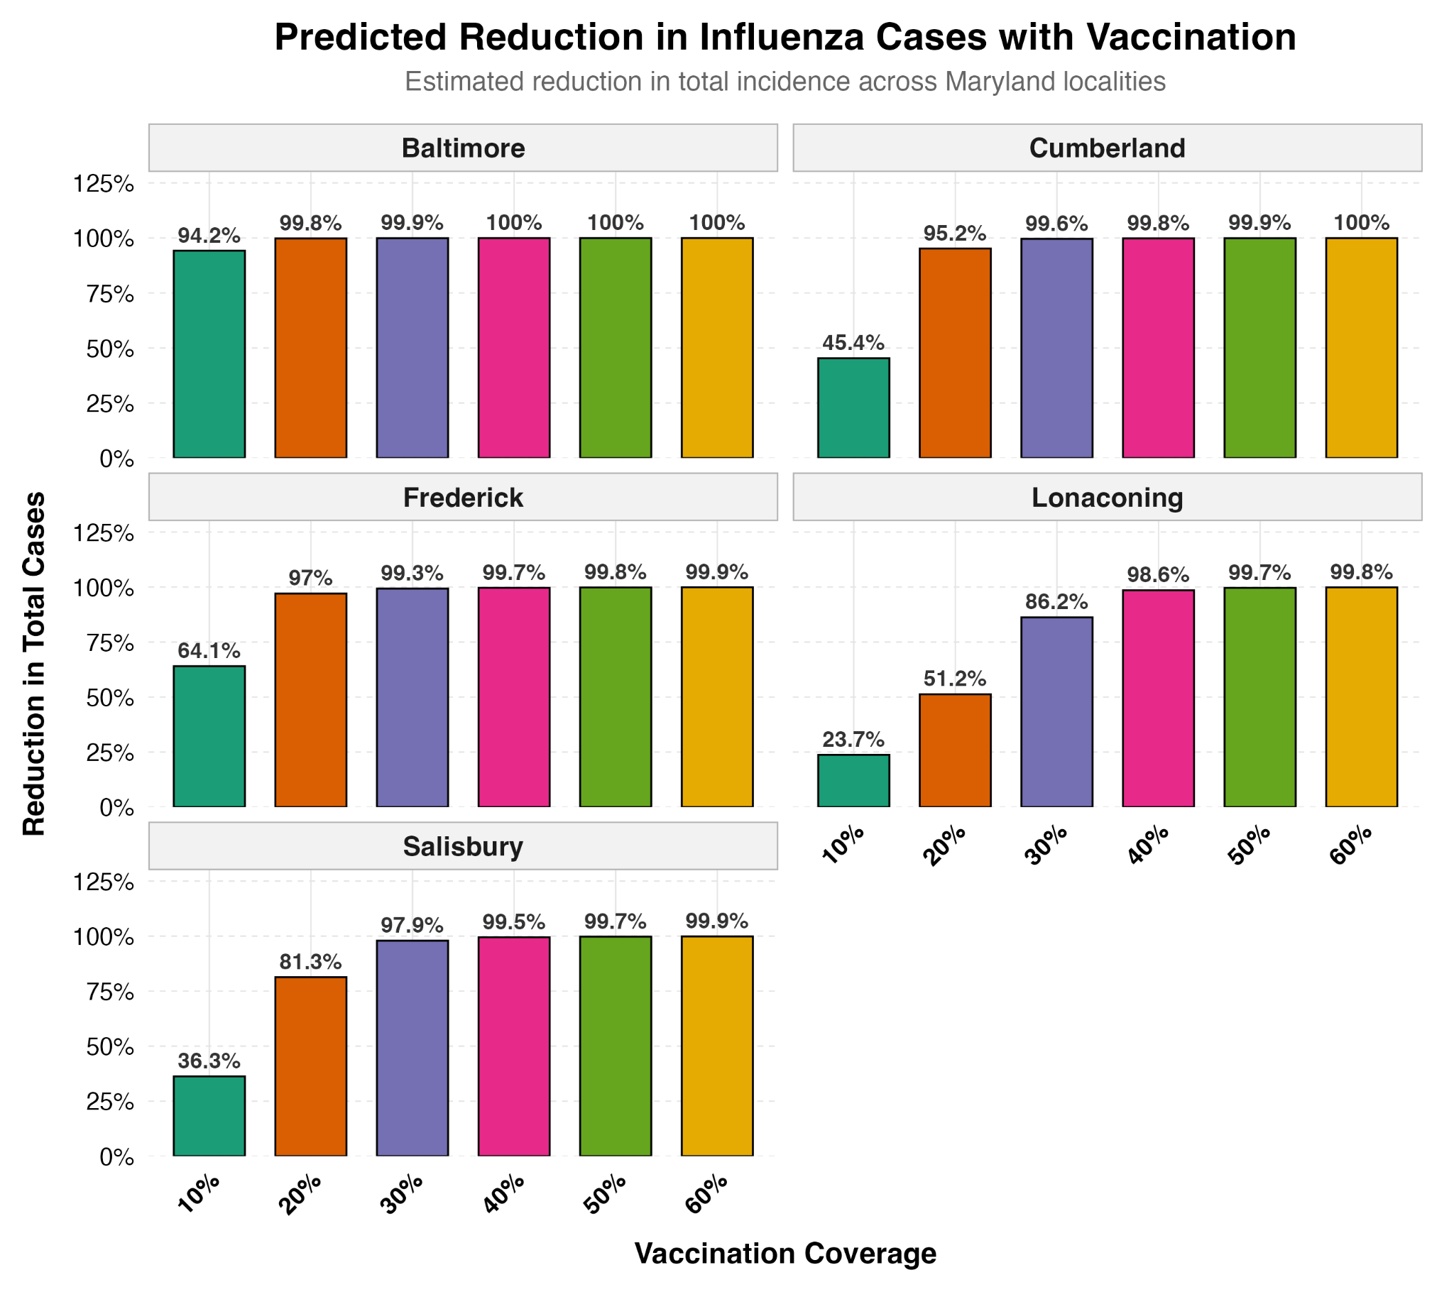
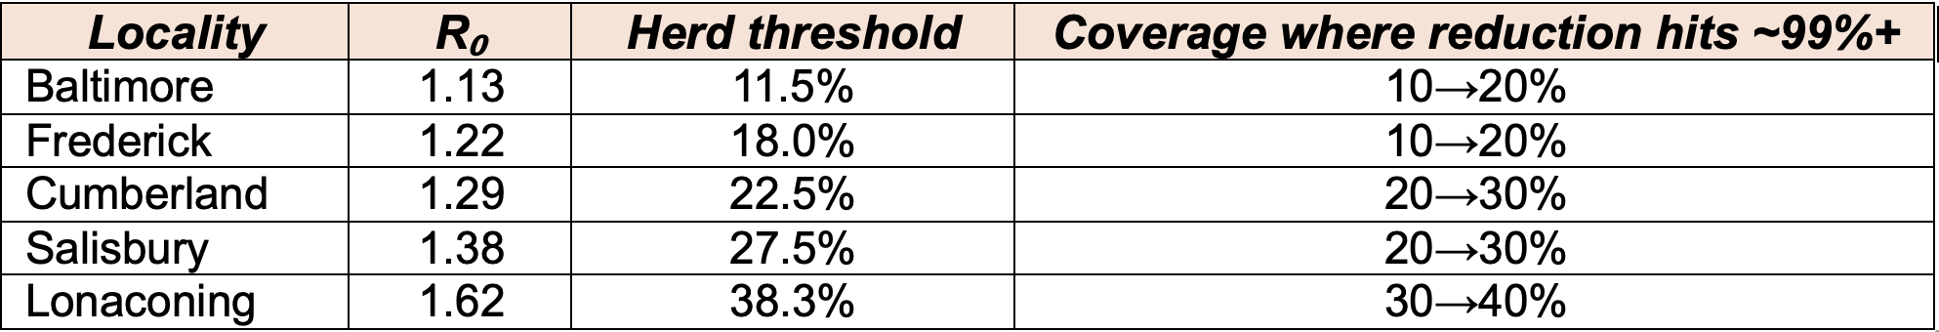
How well can SIR and SEIR models reproduce the 1918 influenza epidemic across five Maryland localities, and what can they tell us about epidemic dynamics and hypothetical vaccination?
How would increasing vaccination coverage have altered the 1918 influenza epidemics across five Maryland localities?
What I did: Using each town's fitted R₀, simulated the epidemic under 10–60% pre-existing vaccine immunity and calculated the resulting reduction in total cases relative to the unvaccinated fit.
Results: The coverage needed to essentially eliminate each outbreak matched the classical herd-immunity threshold, 1 − 1/R₀ — the clinically actionable number.
Additional figures, tables, and supplementary analyses are available through the Google Drive link: Findings (Figures/Tables)
Figure: the "Predicted Reduction in Influenza Cases with Vaccination" bar chart (all 5 towns, 10–60% coverage).
Fadia Ashmawi

Slide 22
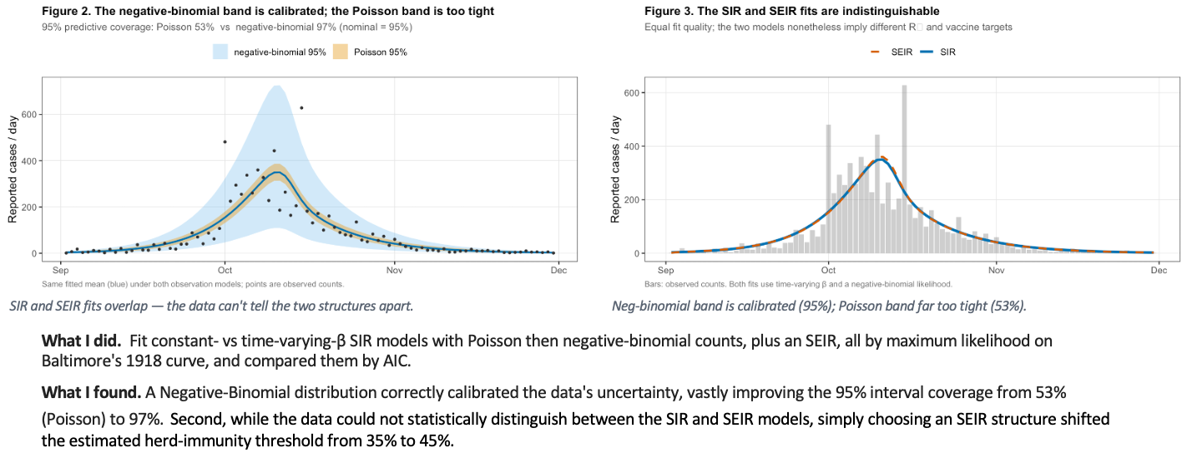
How much does the choice of model change our epidemiological conclusions?
Lena Alghamdi

Slide 23
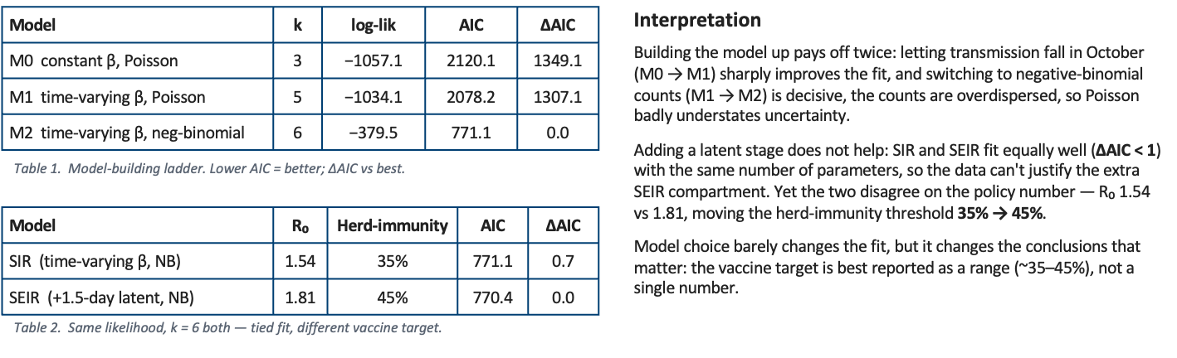
How much does the choice of model change our epidemiological conclusions?
Lena Alghamdi

Slide 24
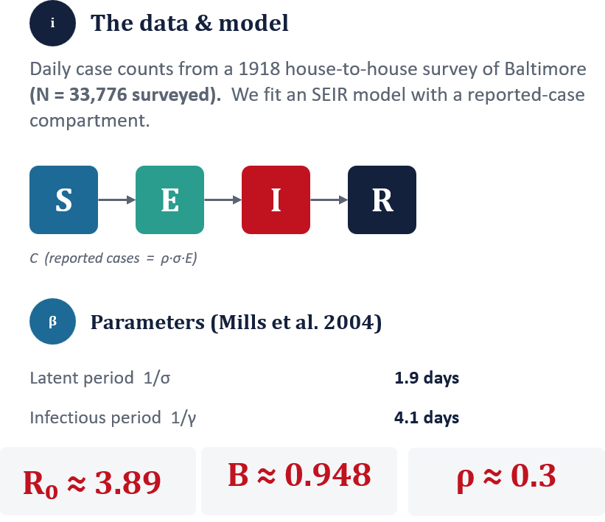
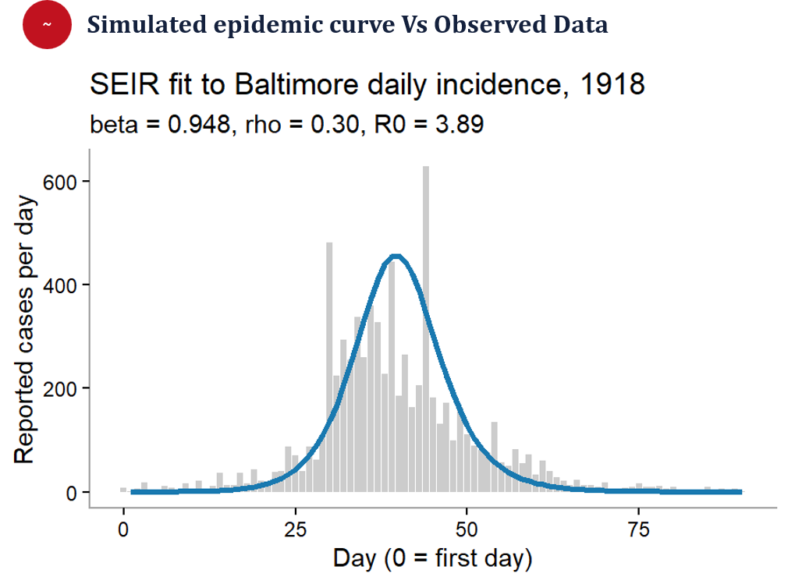
Modelling the 1918 Influenza Pandemic ~ Yasir

Slide 25
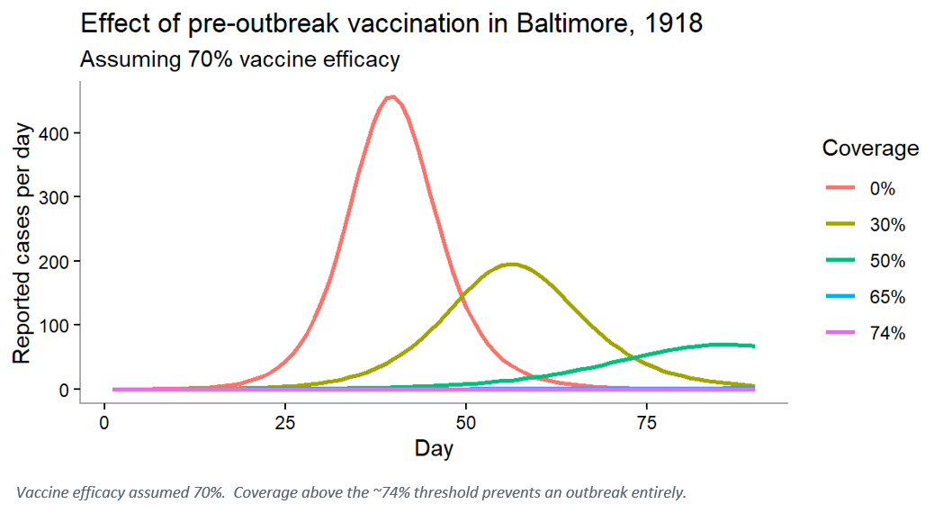
Could a vaccine have stopped it?
Herd-immunity threshold ~ pᴄ = 1 − 1/R₀
With R₀ ≈ 3.83, about 74% of people must be immune. Since ~22% already were, a vaccine would only need to reach the remaining gap — roughly 52 points more.
22%
already immune before the fall wave (herald wave)
74%
must be immune to prevent an outbreak (perfect vaccine)
coverage needed if NO initial immunity exist in the population at 70% vaccine efficacy!
96%

Slide 26
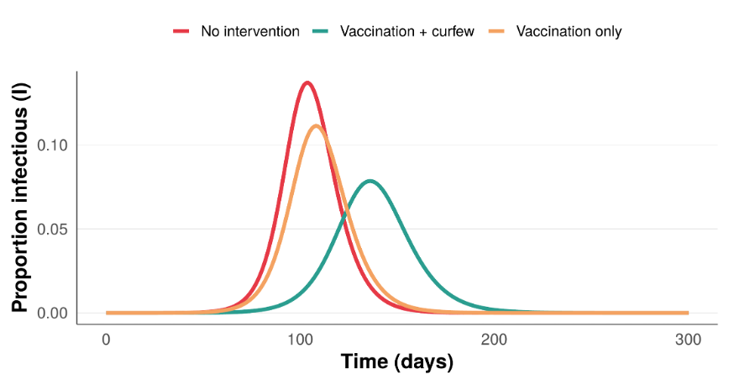
What would a 4-hour daily curfew plus vaccination do to a SARS-CoV-2 outbreak?
WHAT I DID
Built a SEIR model for SARS-CoV-2 (R₀=3, N=1,000,000) from literature parameters, then compared three scenarios: no intervention, vaccination alone (0.1% of the population per day), and vaccination combined with a 4-hour daily curfew (16.7% cut in transmission).
RESULT
Vaccination alone modestly reduced and delayed the peak (~19% lower). Adding a 4-hour curfew was far more effective, cutting the peak by ~43% and delaying it by over a month (day 104 to day 136) — mobility restriction did more work than vaccination alone.
Haitham Alahmadi

Slide 27
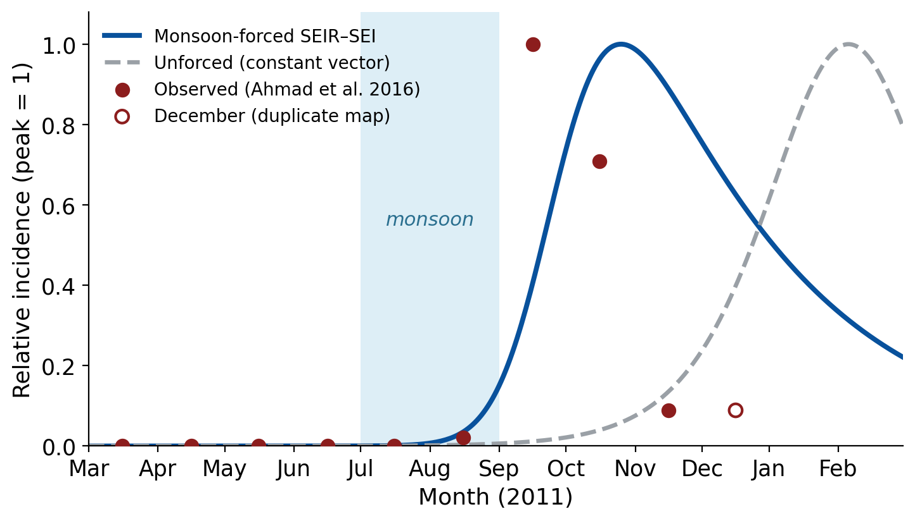
Does the 2011 Lahore dengue epidemic's timing require seasonal (monsoon) vector forcing?
METHOD
• Built a host-vector SEIR (human) x SEI (mosquito) model in R (deSolve).
• Mosquito density seasonally forced (monsoon); run vs an unforced constant-vector control.
• Parameters fixed from literature; compared to monthly incidence digitised from Ahmad et al. (2016).
RESULT & CONCLUSION
• Only the monsoon-forced model reproduces the observed timing (quiet spring → autumn epidemic); the unforced model peaks in February.
• So the outbreak's timing is driven by seasonal mosquito dynamics, not transmission alone.
• The forced model still peaks ~1 month late, a limit of the single-patch structure.
Fig. 1 Normalised daily incidence: monsoon-forced SEIR–SEI (solid) vs unforced constant-vector (dashed), with province-wide monthly incidence digitised from the paper's district maps (points; open = duplicated Dec map). Shaded band = monsoon (Jul–Aug). Each series scaled to its own peak.
Thikra · Data: Ahmad et al. (2016) IJACSA 7(5) - monthly totals read from the paper's district maps. Parameters: Chan & Johansson (2012); Duong et al. (2015); Andraud et al. (2012); Zahid et al. (2023).

Slide 28
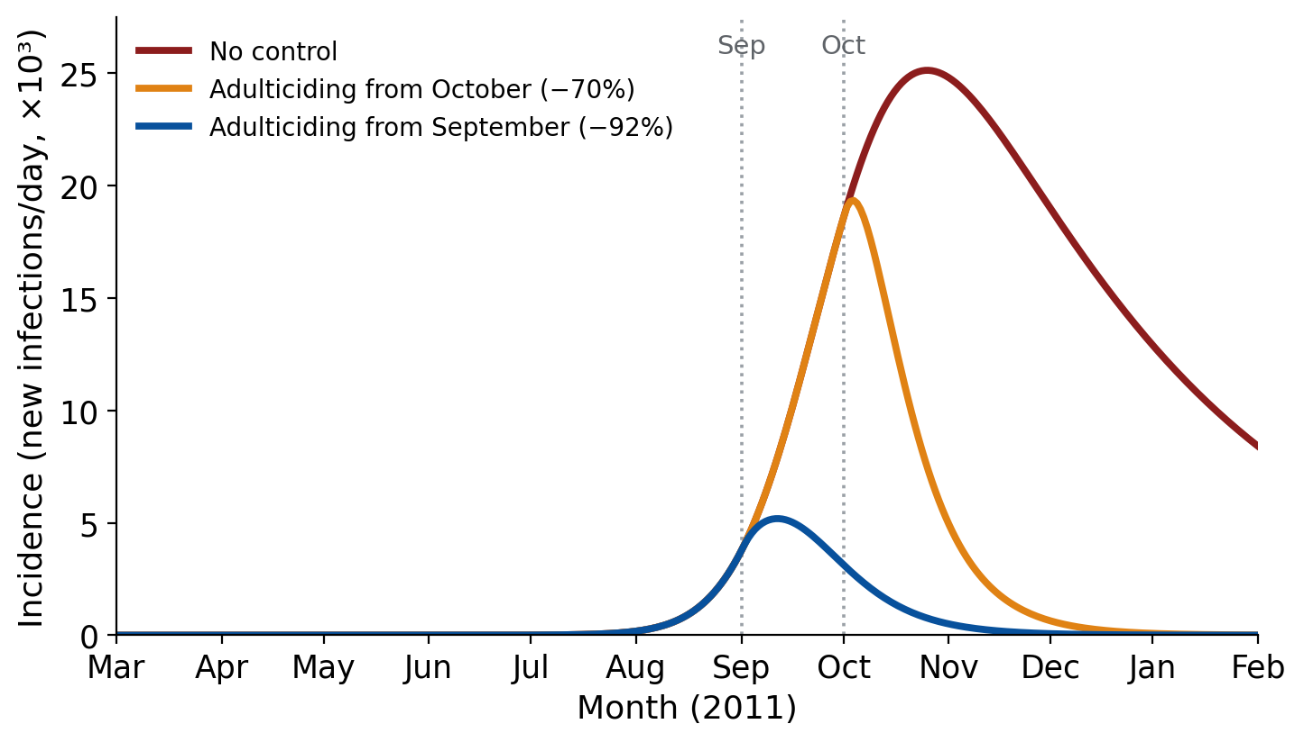
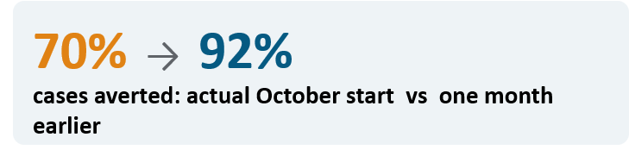
Would earlier vector control (adulticiding) have reduced the 2011 epidemic?
METHOD
• Using the same model, represented fogging as a doubling of adult mosquito mortality from a chosen start day.
• Compared the actual October 2011 spray start with a one-month-earlier (September) start and with no control.
RESULT & CONCLUSION
• Peak incidence was September but control began October → applied post-peak
• Effect size scales with assumed efficacy; the direction, earlier is better than later, is robust.
Fig. 2 Modelled daily incidence (new infections per day) under no control (red), adulticiding from October (orange) and from September (blue). Dotted lines mark spray-start days; fogging = doubling of adult mosquito mortality μM.
Thikra · Data: Ahmad et al. (2016) IJACSA 7(5) - monthly totals read from the paper's district maps. Parameters: Chan & Johansson (2012); Duong et al. (2015); Andraud et al. (2012); Zahid et al. (2023).

Slide 29
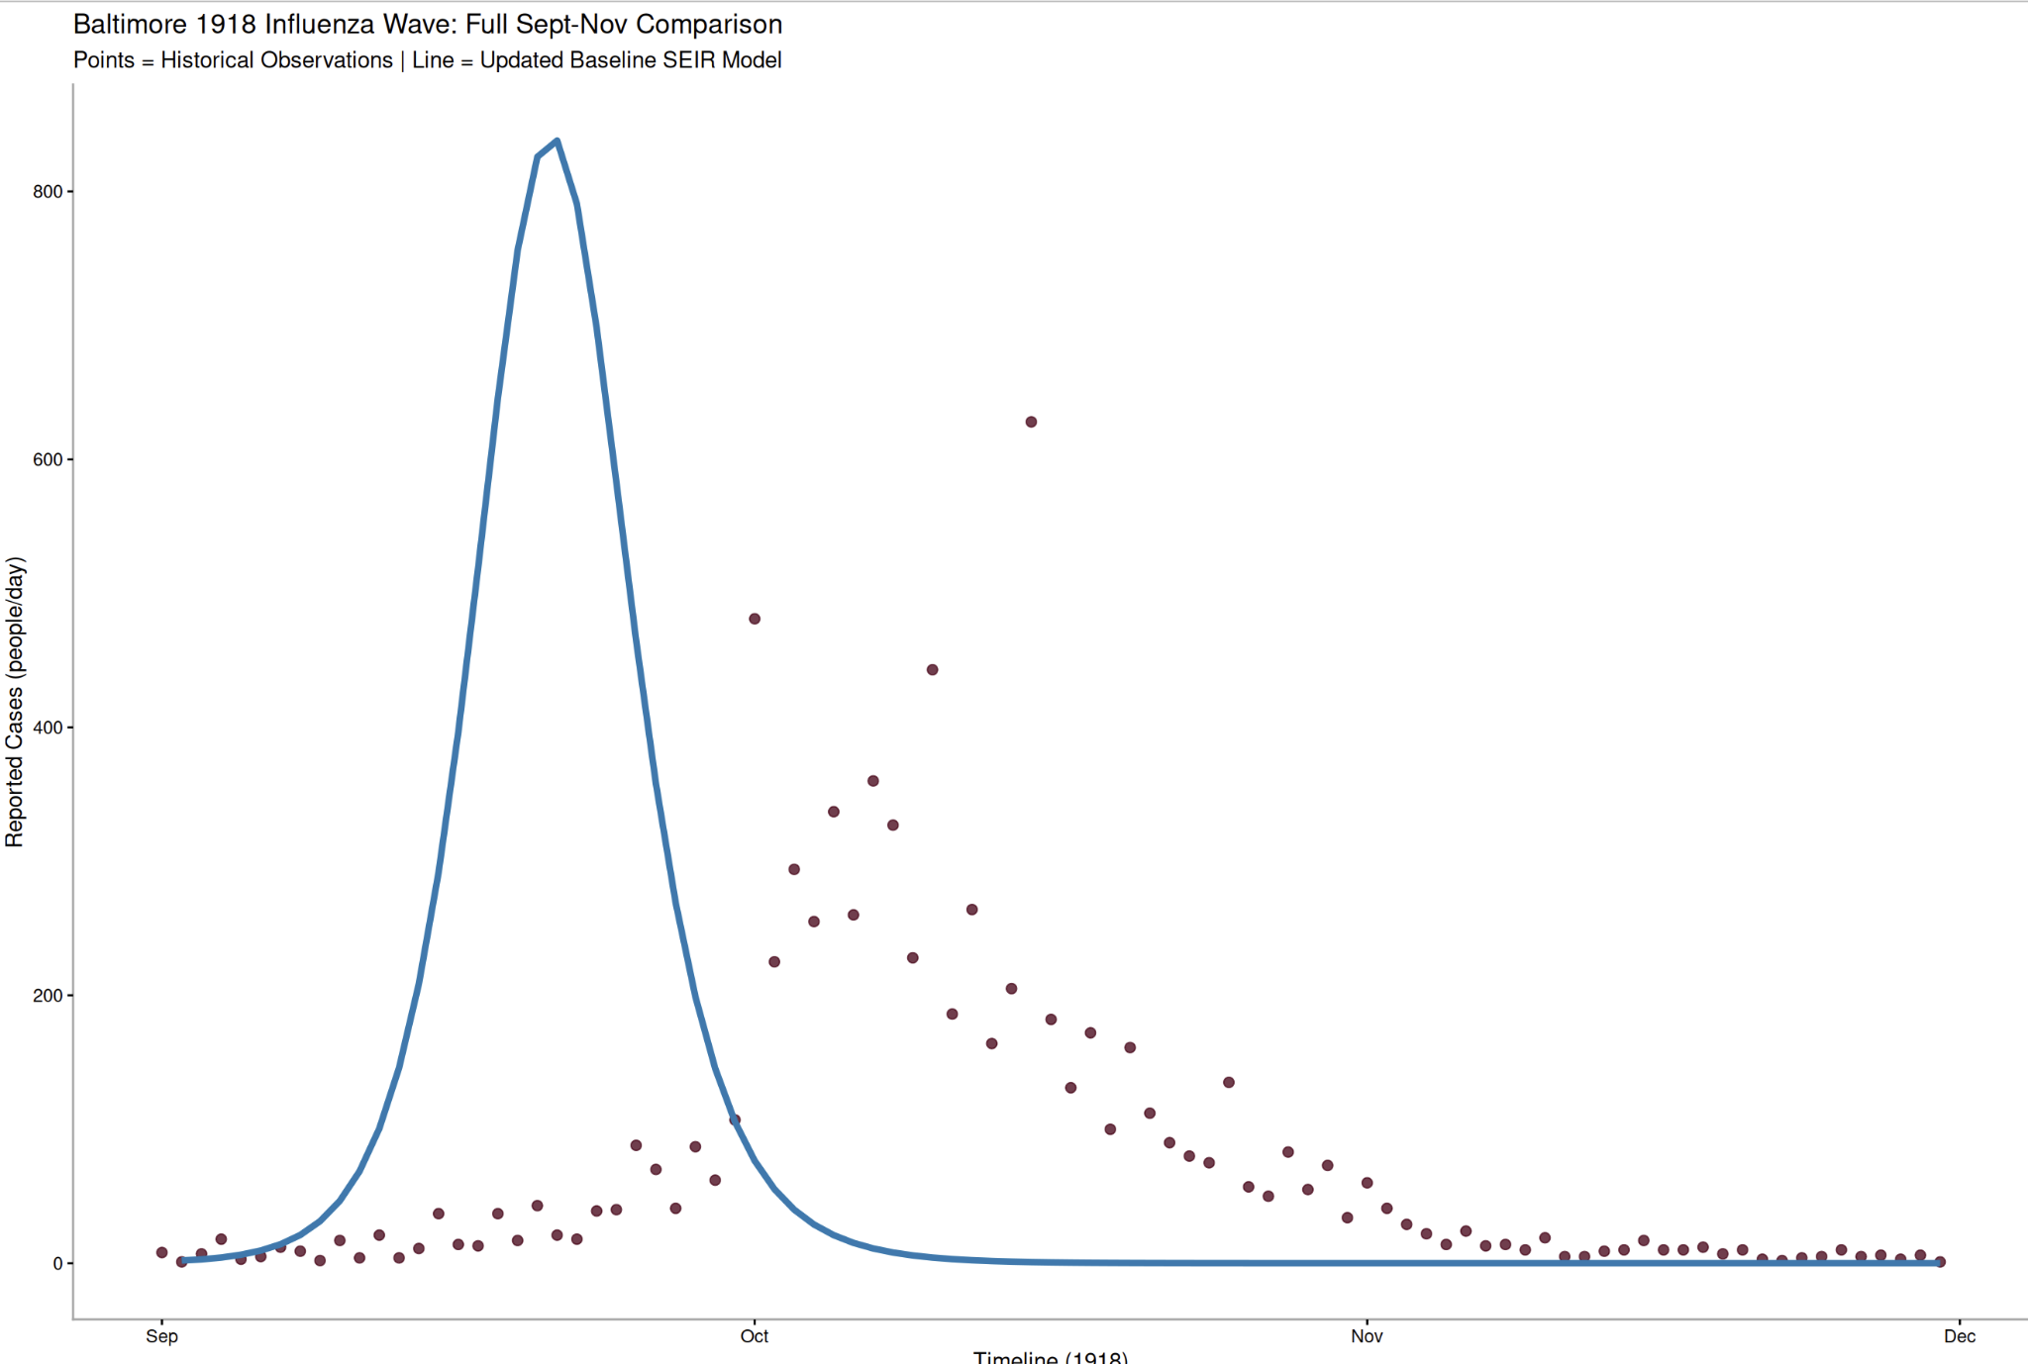
How do we model & calibrate the unmitigated 1918 influenza wave in Baltimore? Ahmed Mawlawi

Slide 30
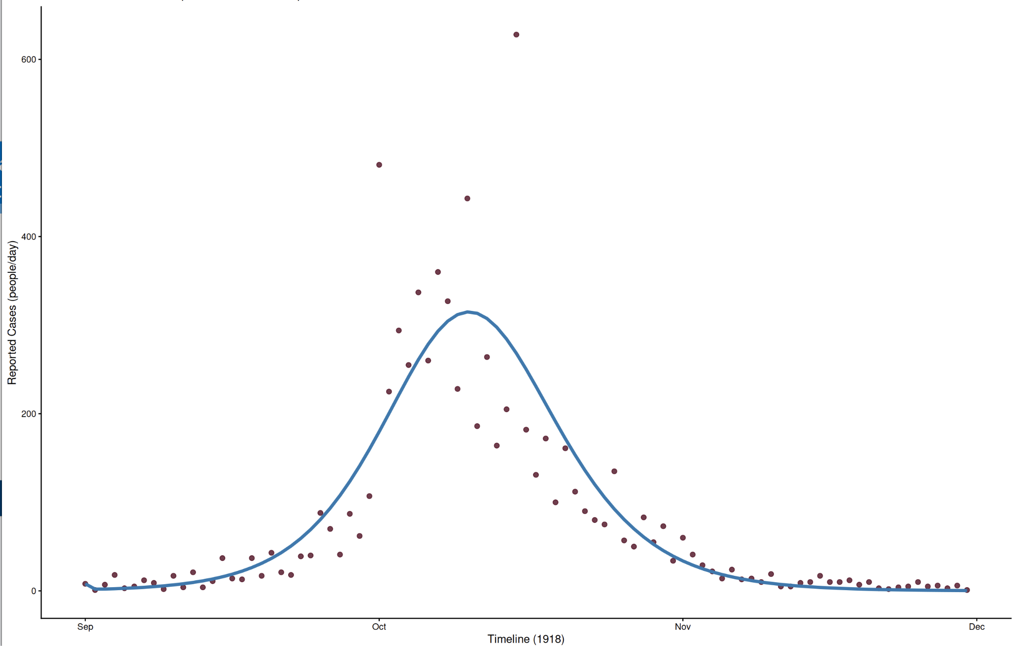
How do we model & calibrate the unmitigated 1918 influenza wave in Baltimore? Ahmed Mawlawi
Analysis: Fitted a SEIR ODE model with a reporting filter to the 91 days timeline using MLE (optim) under Poisson distribution.
Conclusions: Calibrated parameters revealed a:
transmission rate ~1.04
reporting fraction ~25%
R0 = 2.08
Insight: The smooth Poisson line tracks the outbreak's timing in a good manner but misses extreme peaks, proving real-world surveillance data is overdispersed.

Slide 31
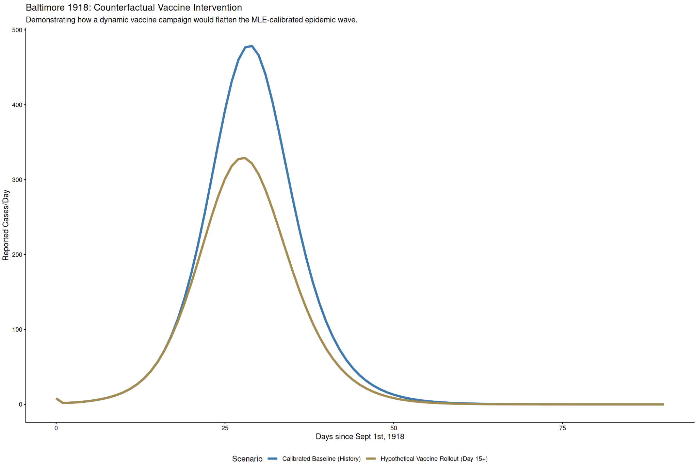
What would be the dynamic public health impact if an influenza vaccine had been available in 1918?
Analysis: policy simulation by adding constant vaccination rate (ψ = 0.015) directly to the calibrated baseline starting on Day 15.
Conclusions: Deploying the vaccine daily to 1.5% of the remaining susceptible pool flattens the wave, cutting peak reported cases from 480 down to 330.
Insight: Outbreak control is a time-sensitive race between natural pathogen transmission and the operational deployment speed of healthcare infrastructure.

